Slide 1
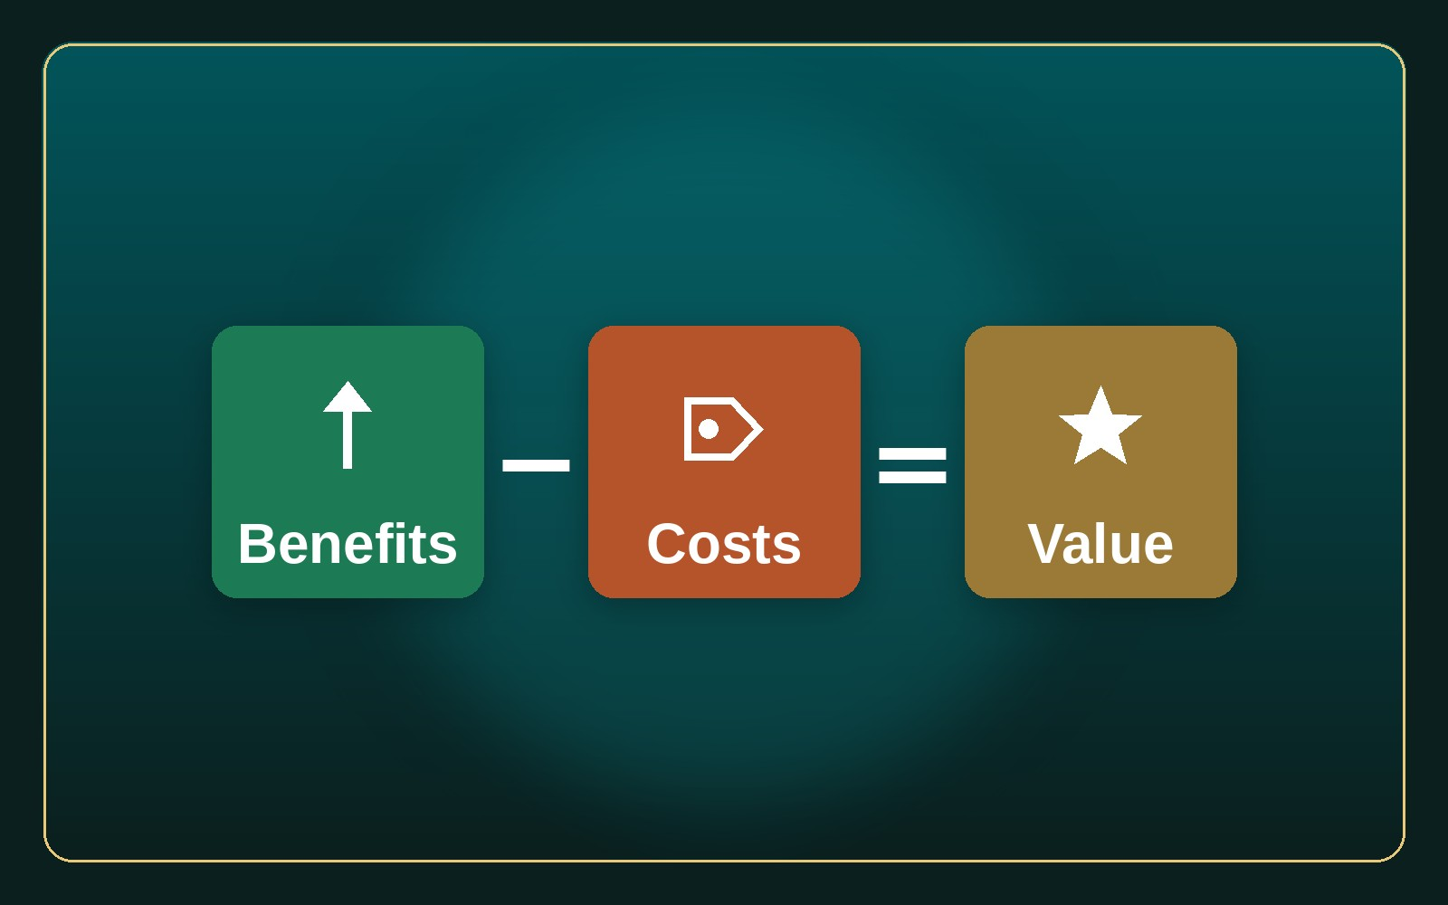
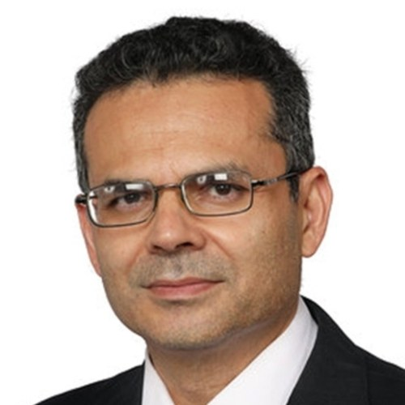
COLLEGE & MBA LECTURE
The Universal Value Creation Framework
Value = Benefits − Costs
Dr. Aftab Ahmad
Lecturer · Value Chain & Strategy · 10 June 2026
The Universal Value Creation Framework · Dr. Aftab Ahmad · azizsaif.com/aftab

Slide 2
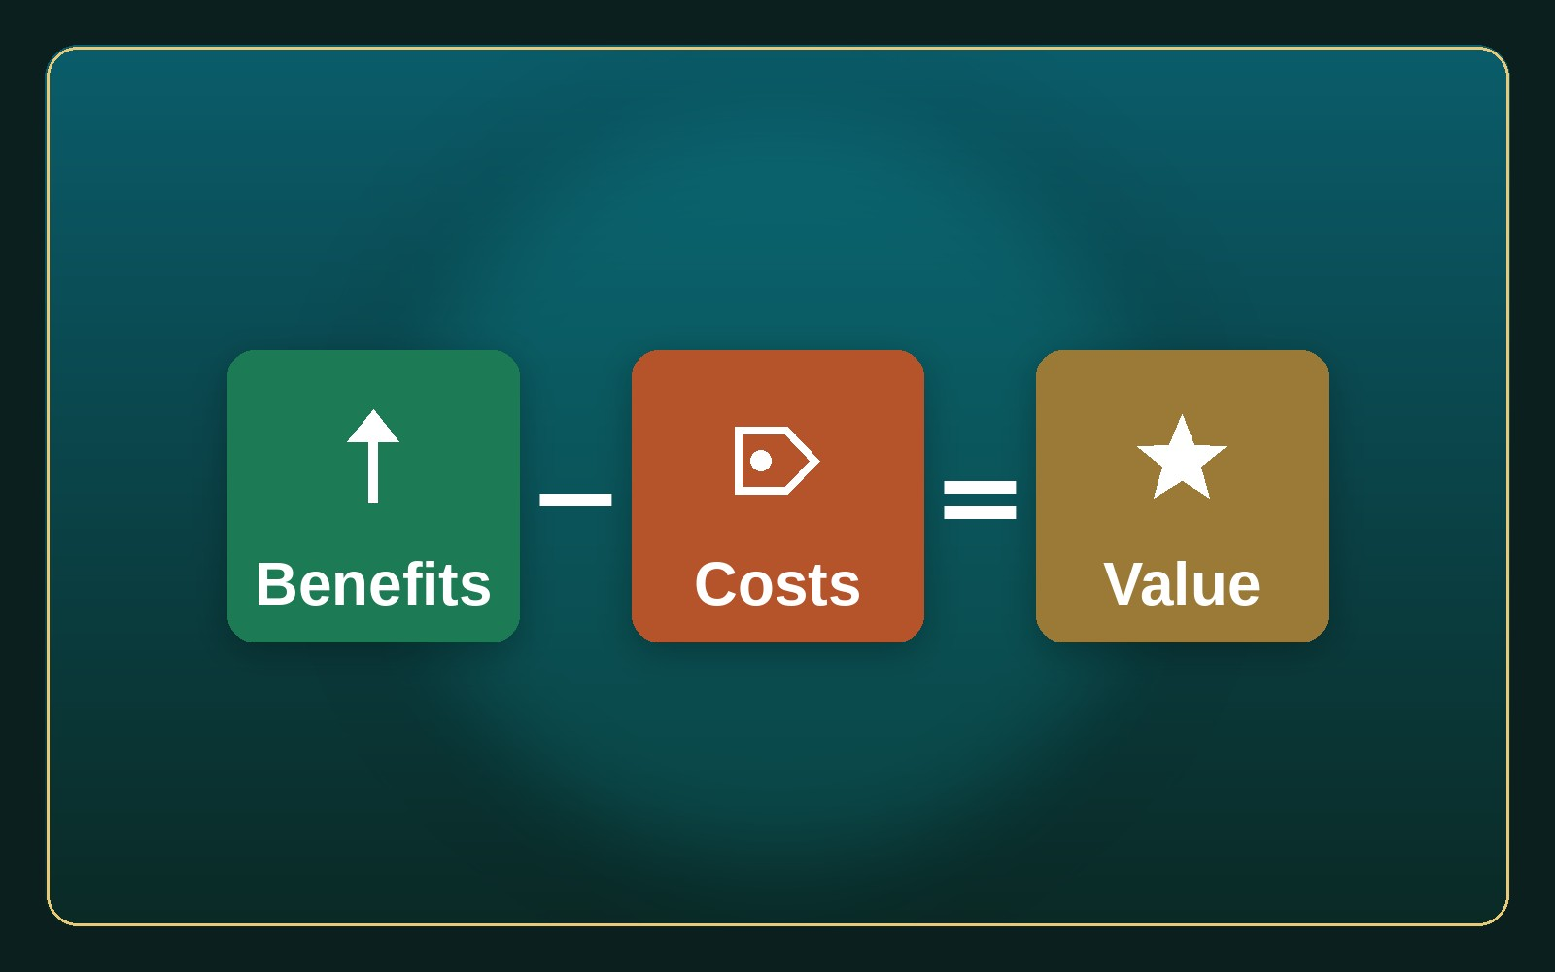
THE CORE EQUATION
Value = Benefits − Costs
▸ Raise benefits; cut cost, risk, effort, time.
▸ For customers, staff, partners & society.
▸ Every innovation traces back to this.
The Universal Value Creation Framework · Dr. Aftab Ahmad · azizsaif.com/aftab
02 / 18

Slide 3
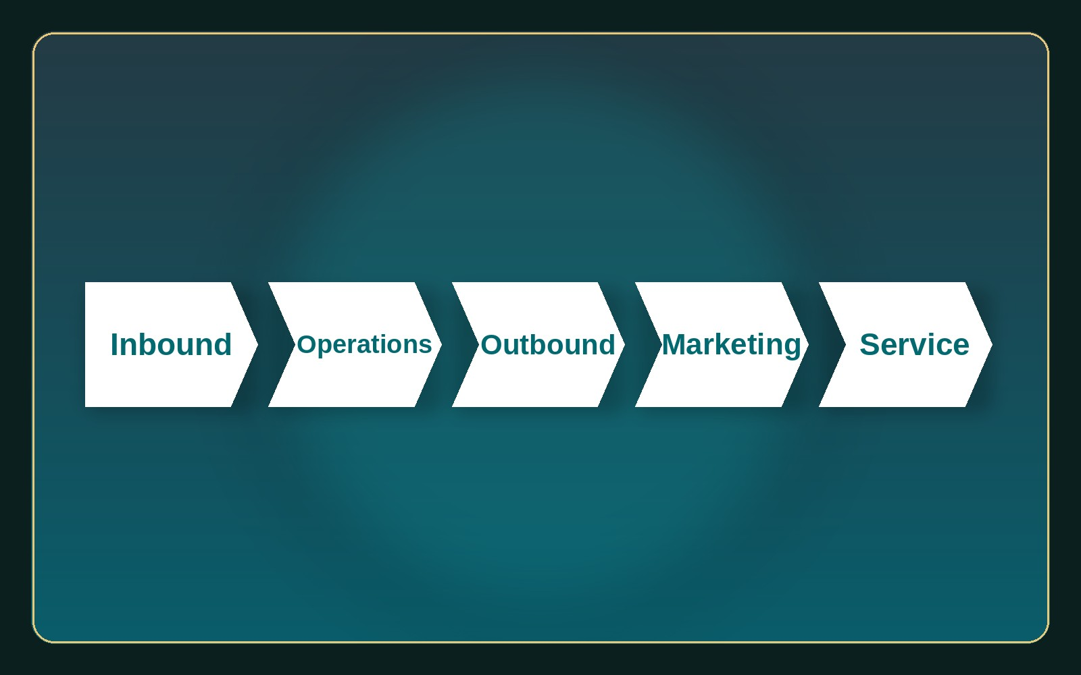
BEYOND PORTER
Why a Universal Framework?
▸ Porter's 1985 chain was built for factories.
▸ Today: services, platforms, software, ecosystems.
▸ VCF fits any business — physical or digital.
▸ Spot the value, then map the chain.
The Universal Value Creation Framework · Dr. Aftab Ahmad · azizsaif.com/aftab
03 / 18

Slide 4
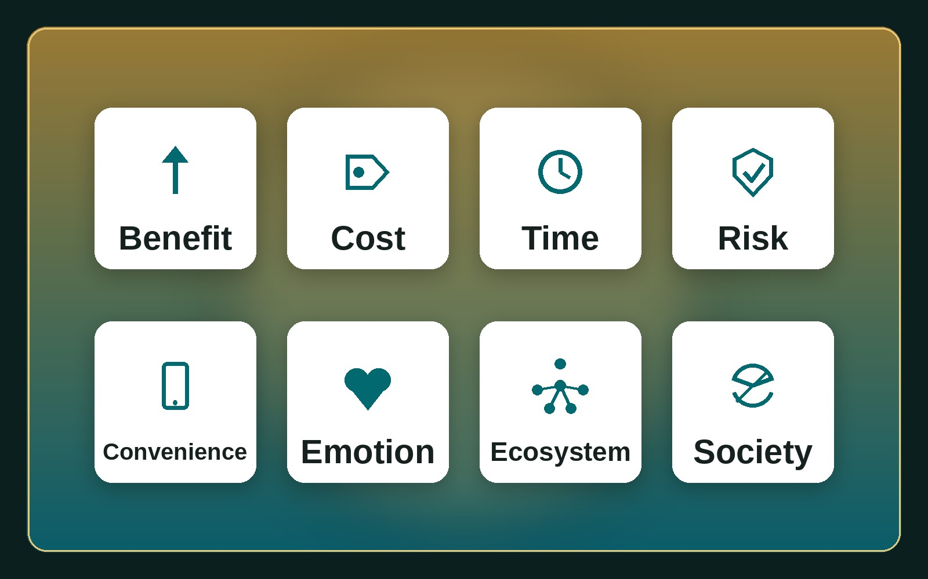
THE FRAMEWORK
The 8 Drivers of Value
▸ 1 Benefits 2 Cost 3 Time 4 Risk
▸ 5 Convenience 6 Emotion
▸ 7 Ecosystem 8 Society
▸ A checklist: which can we push hardest?
The Universal Value Creation Framework · Dr. Aftab Ahmad · azizsaif.com/aftab
04 / 18

Slide 5
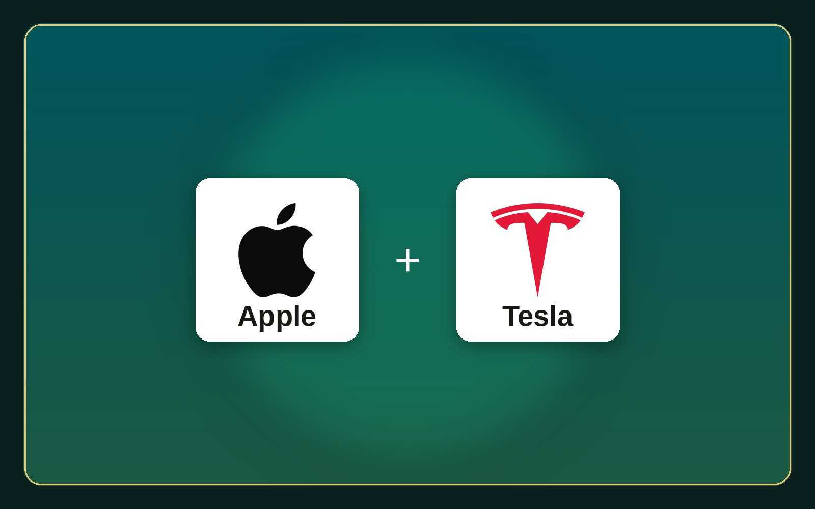
DRIVER 1
Increase Customer Benefits
▸ Help customers achieve more.
▸ Better quality, features, outcomes.
▸ Apple → the whole experience.
▸ Tesla → updates improve the car.
The Universal Value Creation Framework · Dr. Aftab Ahmad · azizsaif.com/aftab
05 / 18

Slide 6
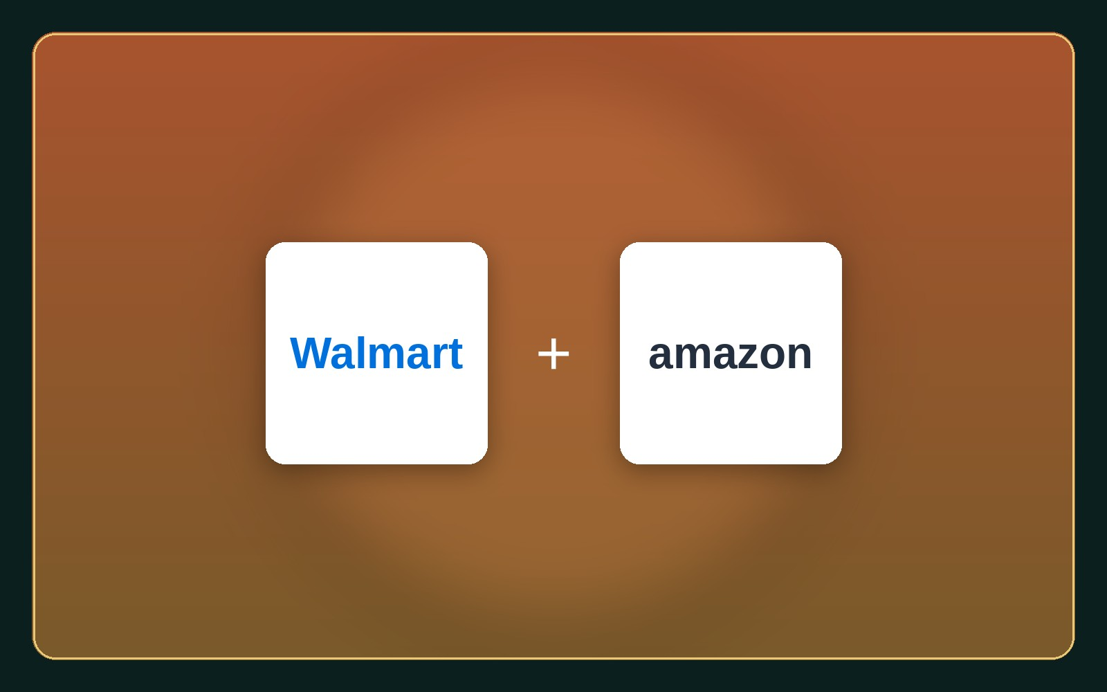
DRIVER 2
Reduce Customer Cost
▸ Make it cheaper to buy and own.
▸ Lower price, running & maintenance cost.
▸ Walmart → scale cuts purchasing cost.
▸ Amazon → cuts search & transaction cost.
The Universal Value Creation Framework · Dr. Aftab Ahmad · azizsaif.com/aftab
06 / 18

Slide 7
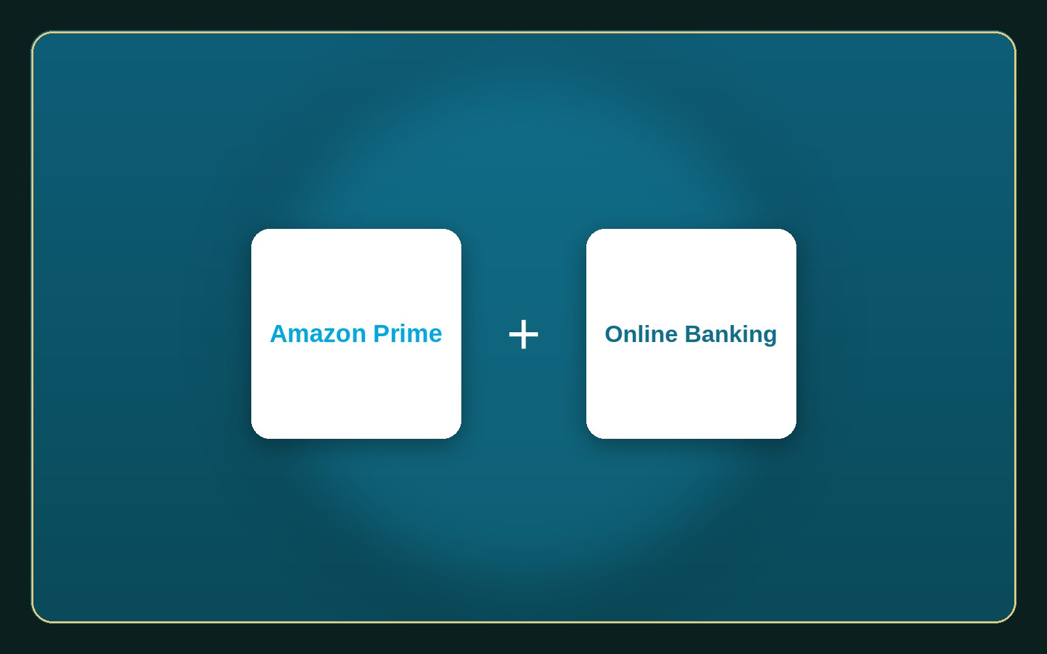
DRIVER 3
Save Time
▸ Help customers do things faster.
▸ Faster delivery, less waiting, automation.
▸ Amazon Prime → same-day delivery.
▸ Online banking → no branch, no queue.
The Universal Value Creation Framework · Dr. Aftab Ahmad · azizsaif.com/aftab
07 / 18

Slide 8
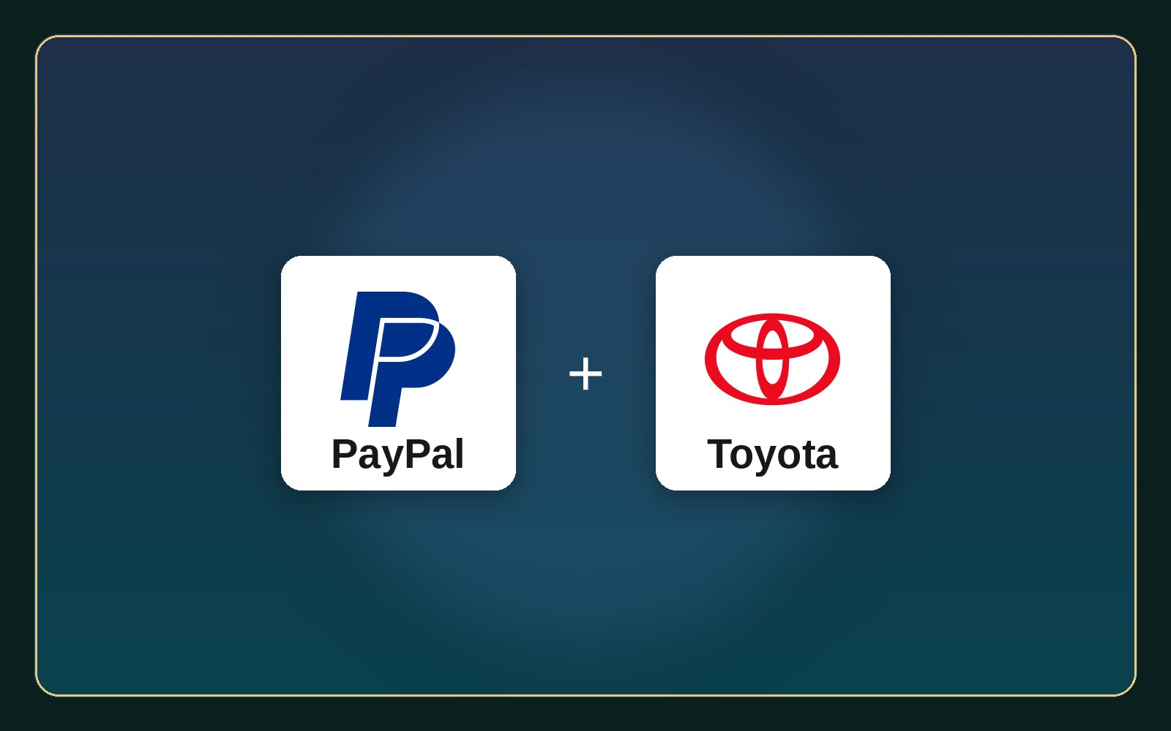
DRIVER 4
Reduce Risk
▸ Make customers feel safer.
▸ Warranties, guarantees, compliance.
▸ PayPal → buyer protection.
▸ Toyota → reliability lowers risk.
The Universal Value Creation Framework · Dr. Aftab Ahmad · azizsaif.com/aftab
08 / 18

Slide 9
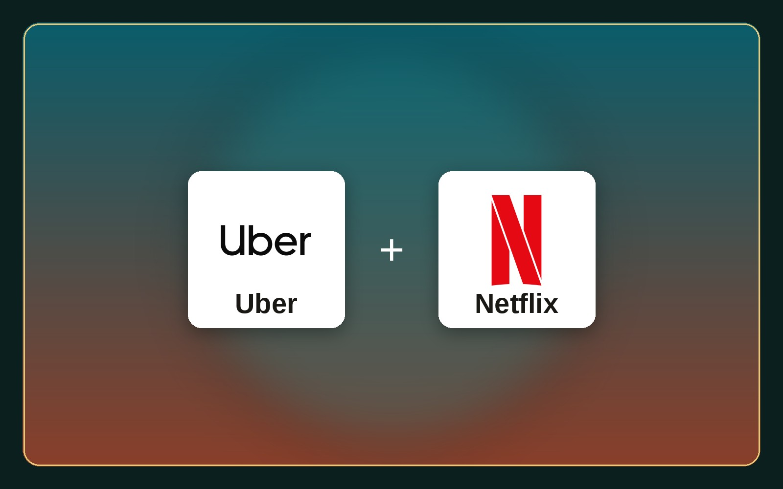
DRIVER 5
Improve Convenience
▸ Make life easier.
▸ Apps, one-stop solutions, simple steps.
▸ Uber → a ride in one tap.
▸ Netflix → a cinema in one app.
The Universal Value Creation Framework · Dr. Aftab Ahmad · azizsaif.com/aftab
09 / 18

Slide 10
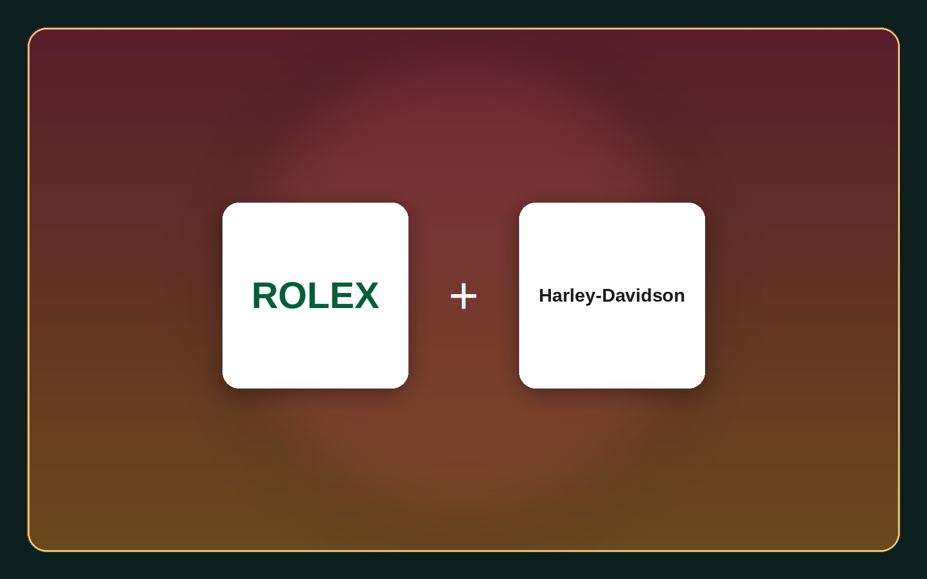
DRIVER 6
Create Emotional Value
▸ Make customers feel better.
▸ Brand, trust, prestige, community.
▸ Rolex → status and achievement.
▸ Harley-Davidson → belonging & identity.
The Universal Value Creation Framework · Dr. Aftab Ahmad · azizsaif.com/aftab
10 / 18

Slide 11
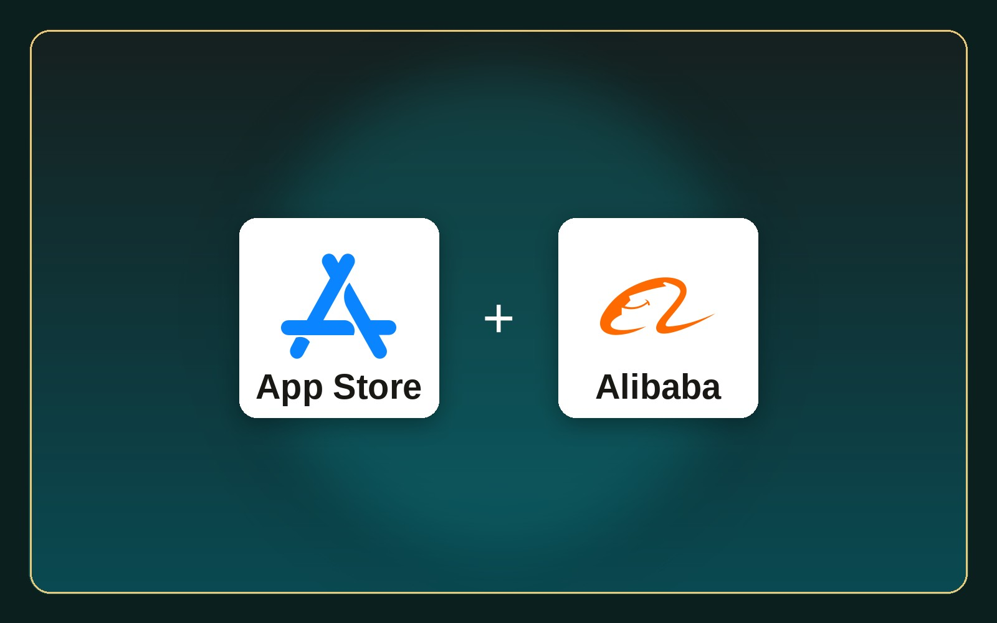
DRIVER 7
Create Ecosystem Value
▸ Value through networks & partners.
▸ Platforms, integration, network effects.
▸ App Store → users + developers win.
▸ Alibaba → buyers, sellers, payments.
The Universal Value Creation Framework · Dr. Aftab Ahmad · azizsaif.com/aftab
11 / 18

Slide 12
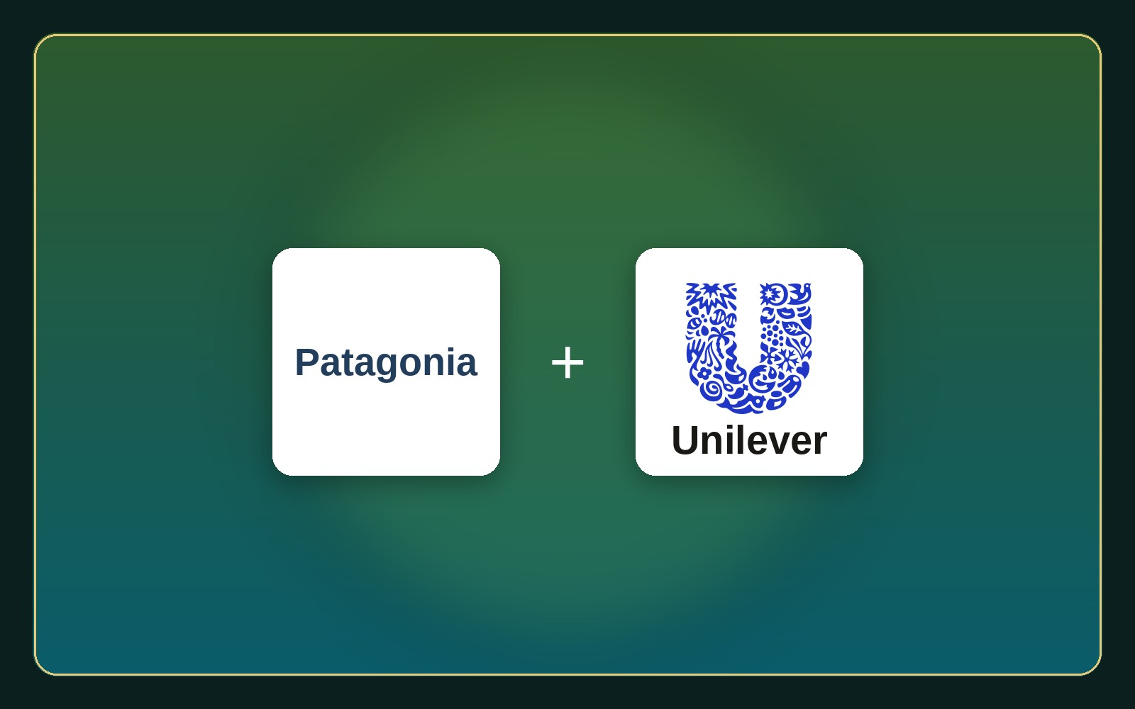
DRIVER 8
Create Societal Value
▸ Help society and sustainability.
▸ Ethics, circular economy, social impact.
▸ Patagonia → environmental responsibility.
▸ Unilever → value beyond the product.
The Universal Value Creation Framework · Dr. Aftab Ahmad · azizsaif.com/aftab
12 / 18

Slide 13
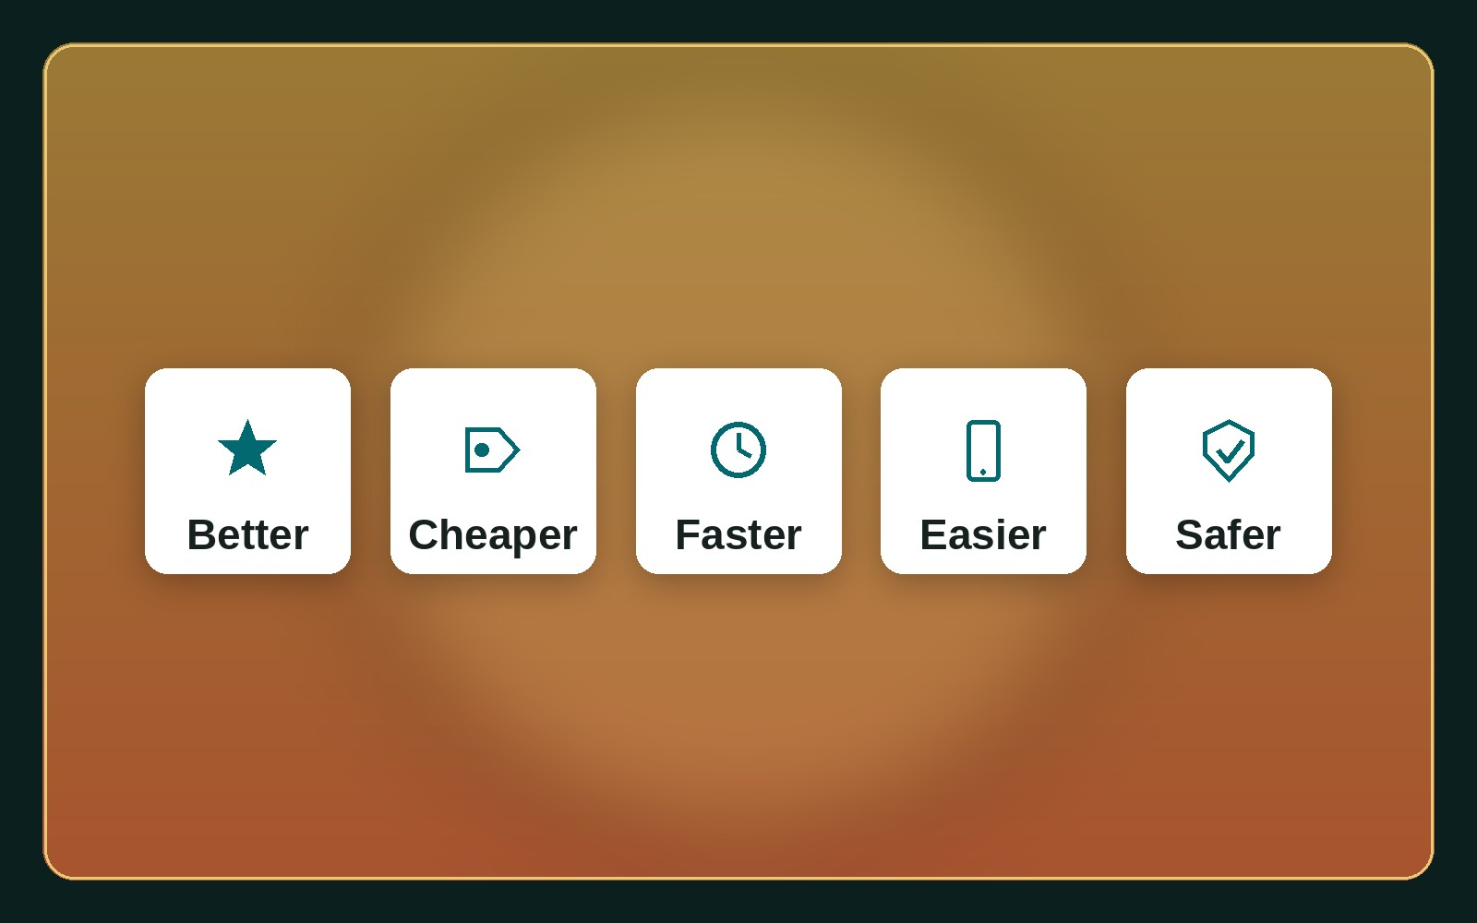
EASY TO REMEMBER
5 Ways to Create Value
▸ Better — quality
▸ Cheaper — cost
▸ Faster — time
▸ Easier — convenience
▸ Safer — risk
The Universal Value Creation Framework · Dr. Aftab Ahmad · azizsaif.com/aftab
13 / 18

Slide 14
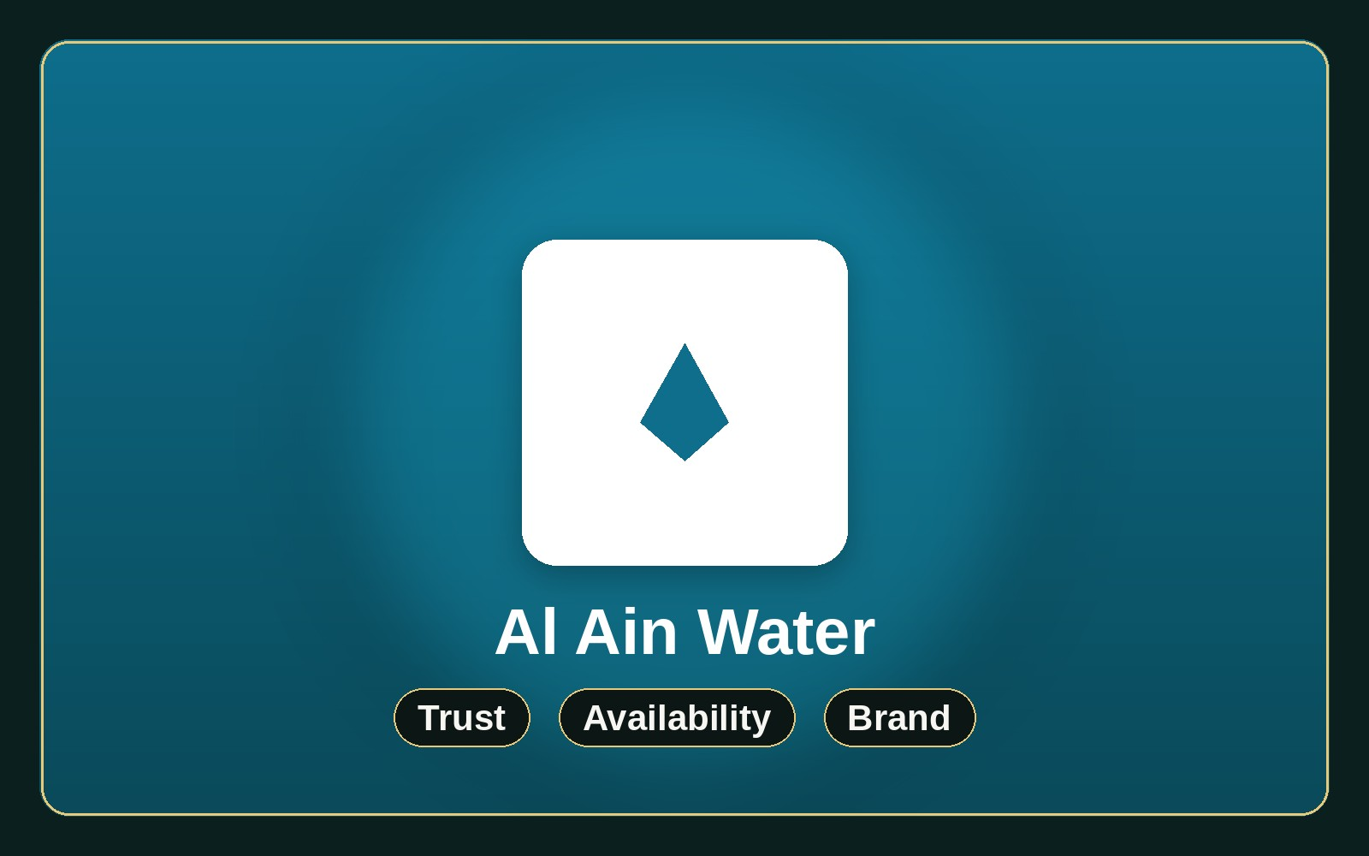
UAE EXAMPLE · FMCG
Al Ain Water
▸ Packaged water — a pure commodity.
▸ Yet chosen over cheaper rivals.
▸ Wins on trust, availability, brand.
▸ Value is in the experience, not just water.
The Universal Value Creation Framework · Dr. Aftab Ahmad · azizsaif.com/aftab
14 / 18

Slide 15
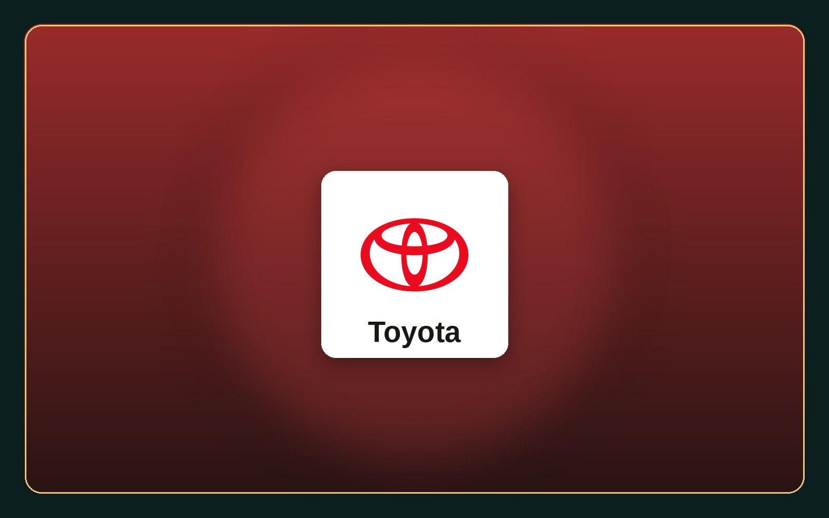
GLOBAL EXAMPLE · AUTO
Toyota
▸ Not simply selling cars.
▸ Lowers total cost of ownership.
▸ Improves safety, protects resale value.
▸ Customers buy minimized risk.
The Universal Value Creation Framework · Dr. Aftab Ahmad · azizsaif.com/aftab
15 / 18

Slide 16
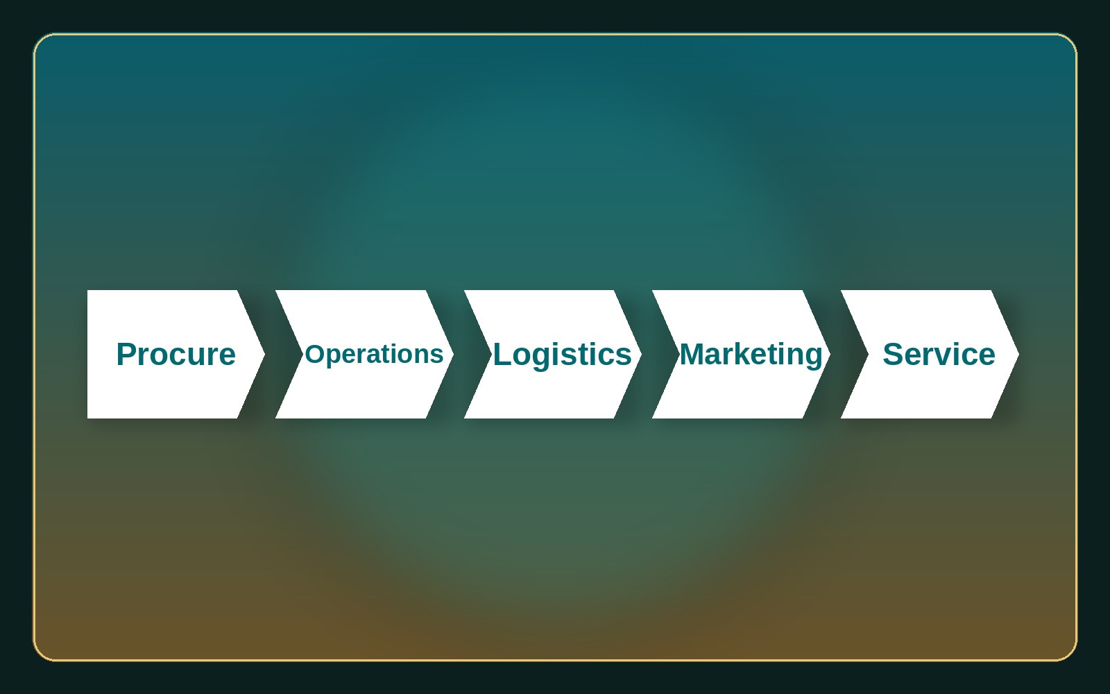
THE VALUE CHAIN LENS
Linking Back to Porter
Al Ain Water
Procure → sourcing
Operations → bottling
Logistics → distribution
Marketing → trust & brand
Service → delivery
Toyota
Procure → supplier quality
Operations → TPS
Technology → hybrid & safety
Marketing → reliability
Service → dealer network
The Universal Value Creation Framework · Dr. Aftab Ahmad · azizsaif.com/aftab
16 / 18

Slide 17
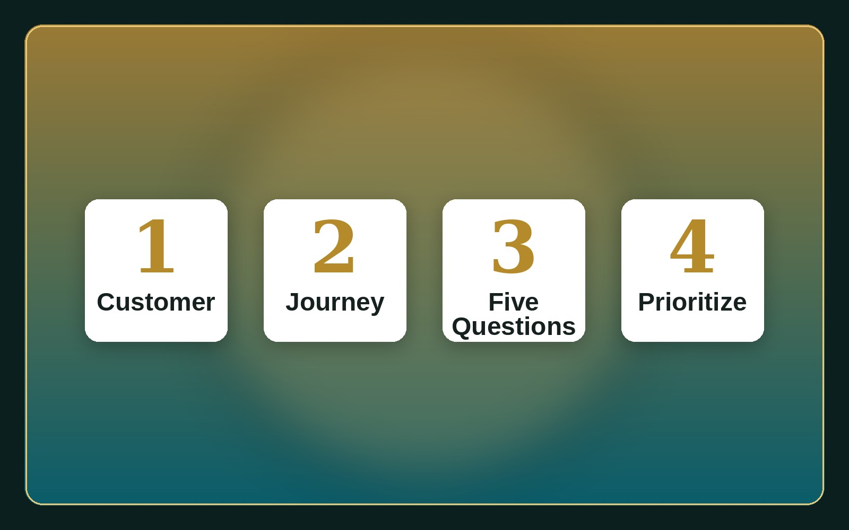
CLASSROOM EXERCISE
Apply It to Any Company
▸ 1 — Who is the customer?
▸ 2 — Map before, during, after.
▸ 3 — Better, cheaper, faster, safer?
▸ 4 — Prioritize the biggest win.
The Universal Value Creation Framework · Dr. Aftab Ahmad · azizsaif.com/aftab
17 / 18

Slide 18
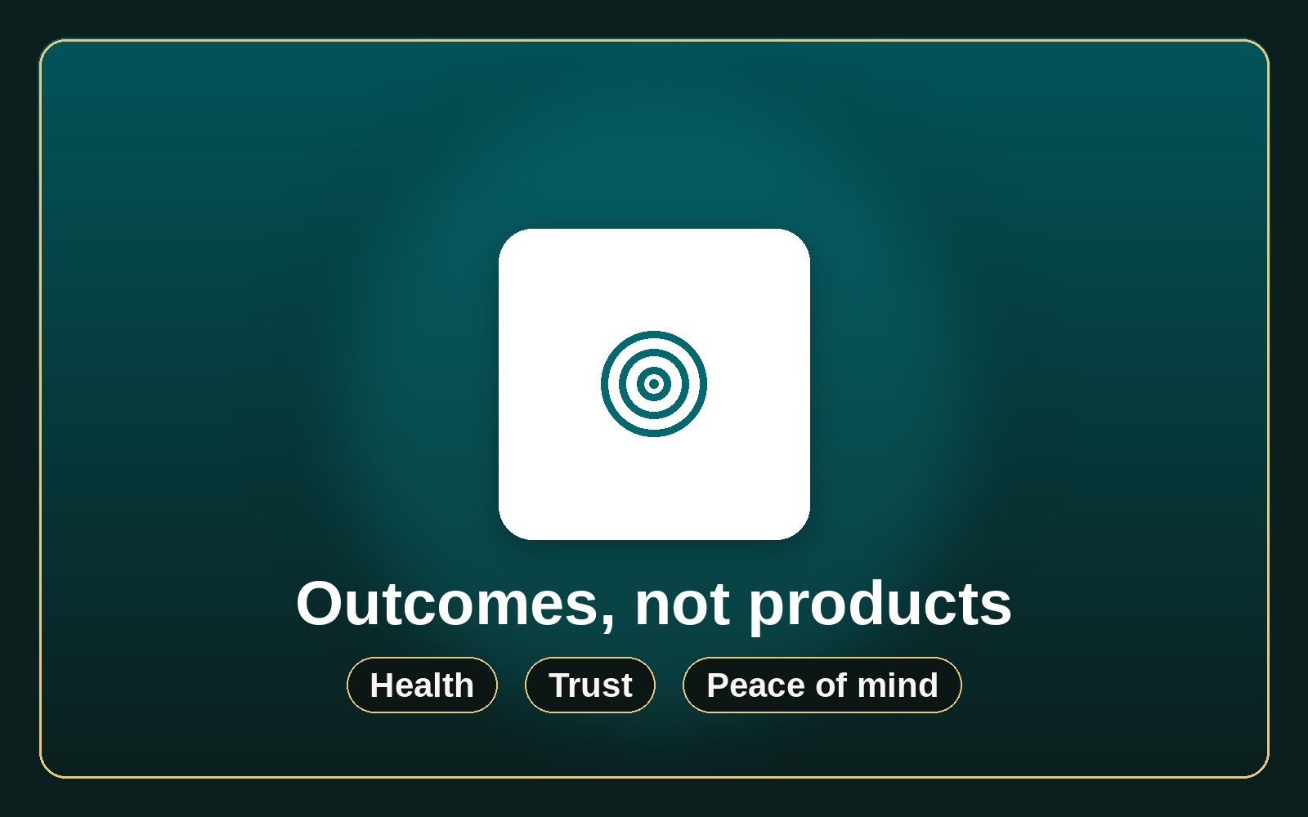
FINAL TAKEAWAY
Customers Buy Outcomes
▸ Outcomes, not products.
▸ Al Ain Water → health, safety, trust.
▸ Toyota → peace of mind, low cost.
Dr. Aftab Ahmad
Thank you · Value Chain & Strategy
The Universal Value Creation Framework · Dr. Aftab Ahmad · azizsaif.com/aftab
18 / 18

