Slide 1
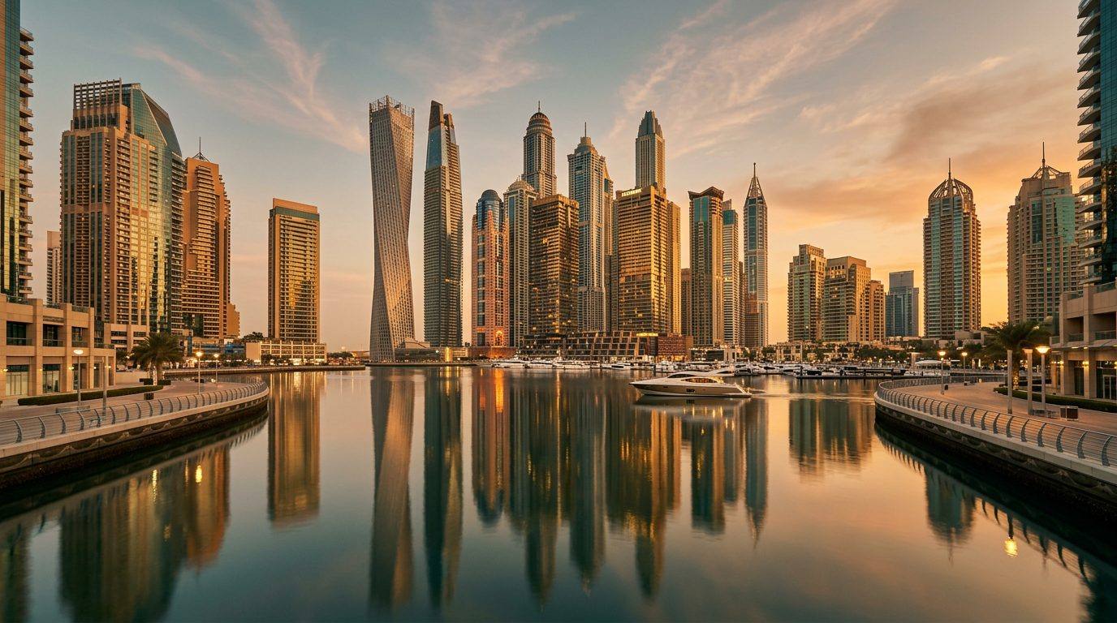
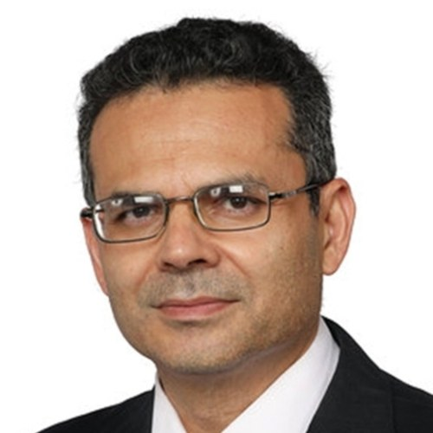
COLLEGE LECTURE
Do You Know What Your
Customers' Aspirations Are?
Based on the HBR article by B. Joseph Pine II
Presented by Dr. Aftab Ahmad
07 June 2026

Slide 2
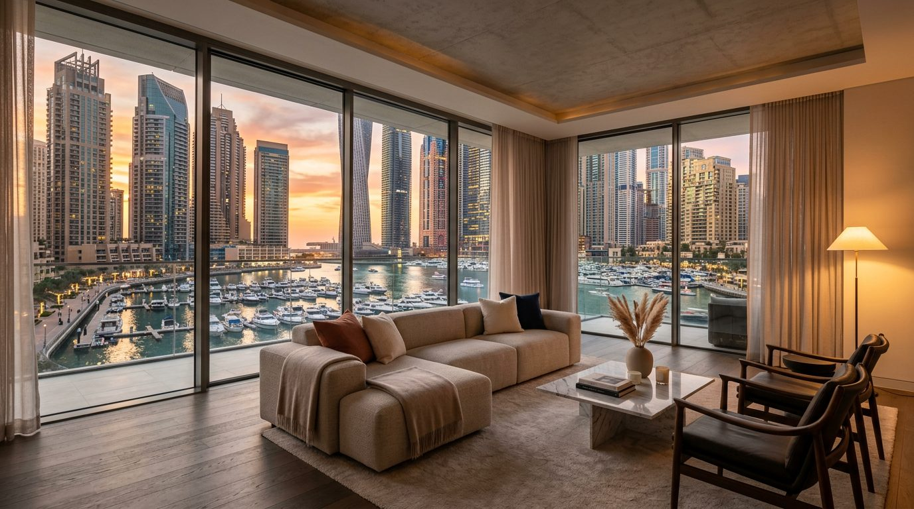

SLIDE 2 OF 15
Opening Question
Why does a customer buy a luxury apartment in Dubai Marina when a cheaper apartment is available elsewhere?
Most students answer: better location, better amenities, investment value.
The deeper answer — the customer is buying an aspiration, not just a property.
They aspire to: a premium lifestyle · social status · international recognition · financial success.
Dr. Aftab Ahmad | College Lecture — 07 June 2026
02 / 15

Slide 3
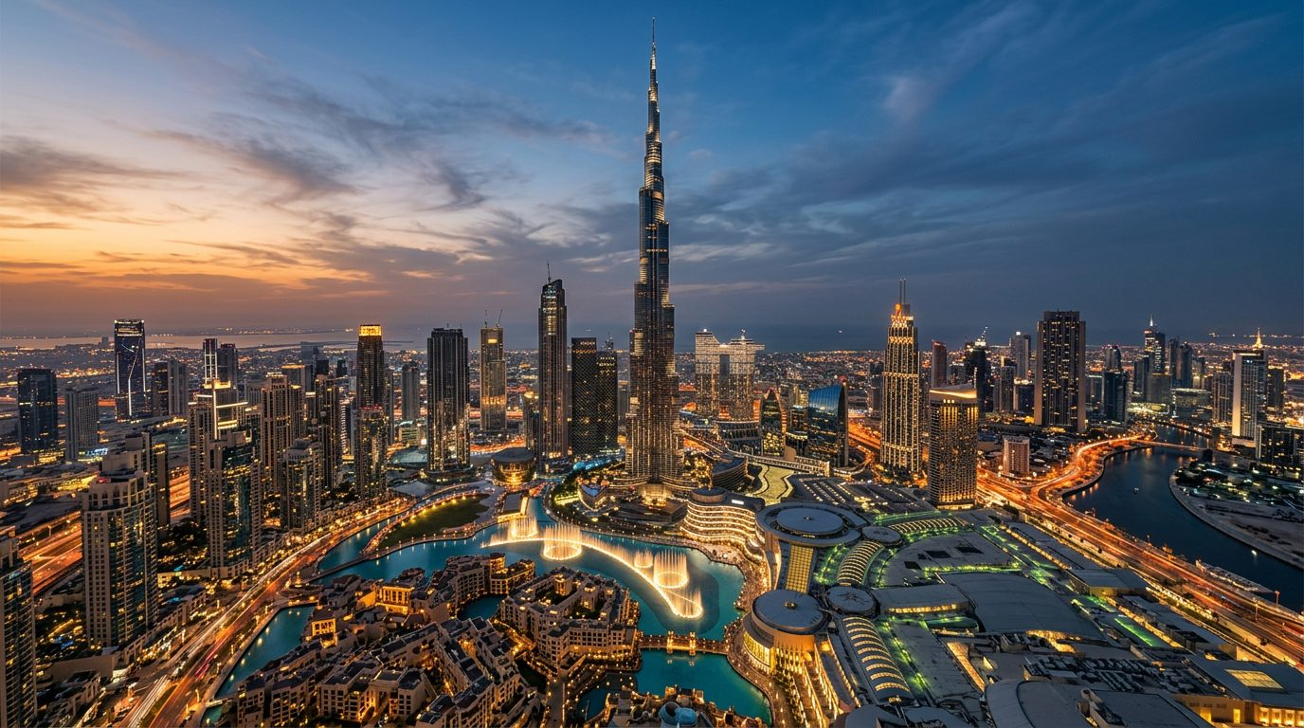
SLIDE 3 OF 15
Understanding the UAE Customer
Multicultural: 200+ nationalities, expat-dominated workforce, diverse consumer motivations.
Visible success: luxury cars, branded lifestyles, premium communities, social-media influence.
Future-oriented society: Vision 2031, Dubai Economic Agenda D33, Smart City, AI Strategy.
Customers are constantly encouraged to think about a better future.
Dr. Aftab Ahmad | College Lecture — 07 June 2026
03 / 15

Slide 4
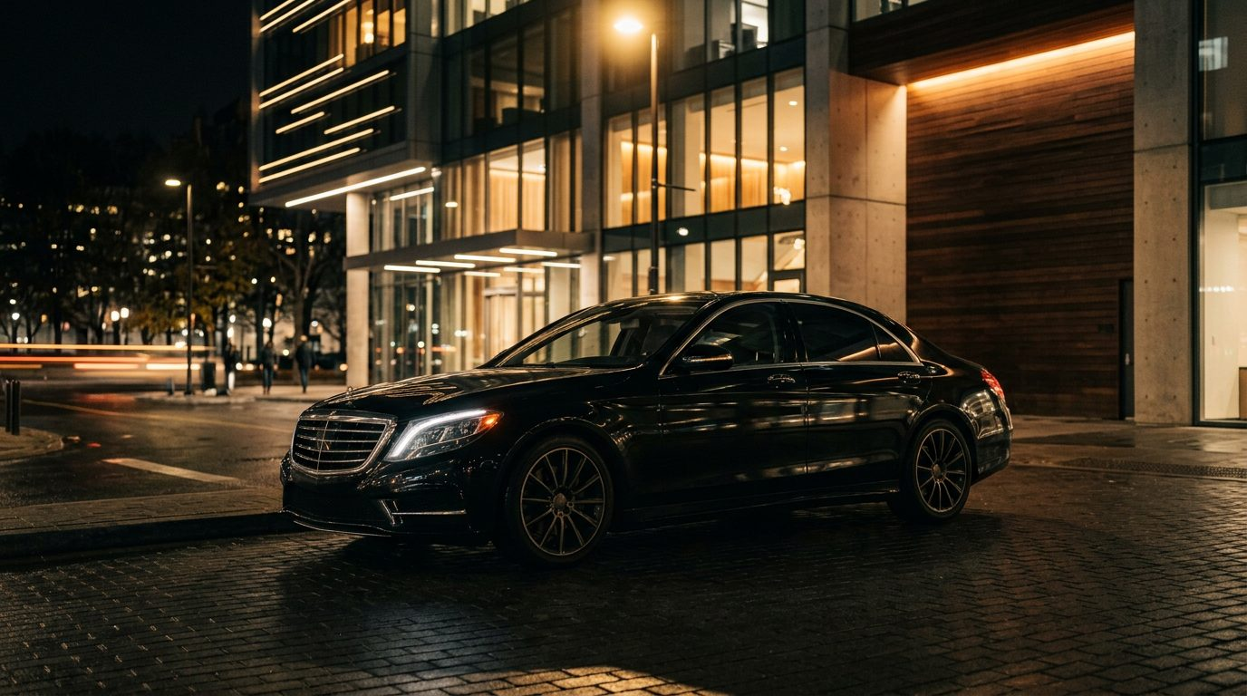
SLIDE 4 OF 15
Traditional vs Aspiration Thinking
TRADITIONAL
ASPIRATION
Need: "I need transportation." Solution: sell a car.
Aspiration: "I want to be perceived as successful." Solution: sell a Mercedes, Tesla, or Range Rover.
Dr. Aftab Ahmad | College Lecture — 07 June 2026
04 / 15

Slide 5
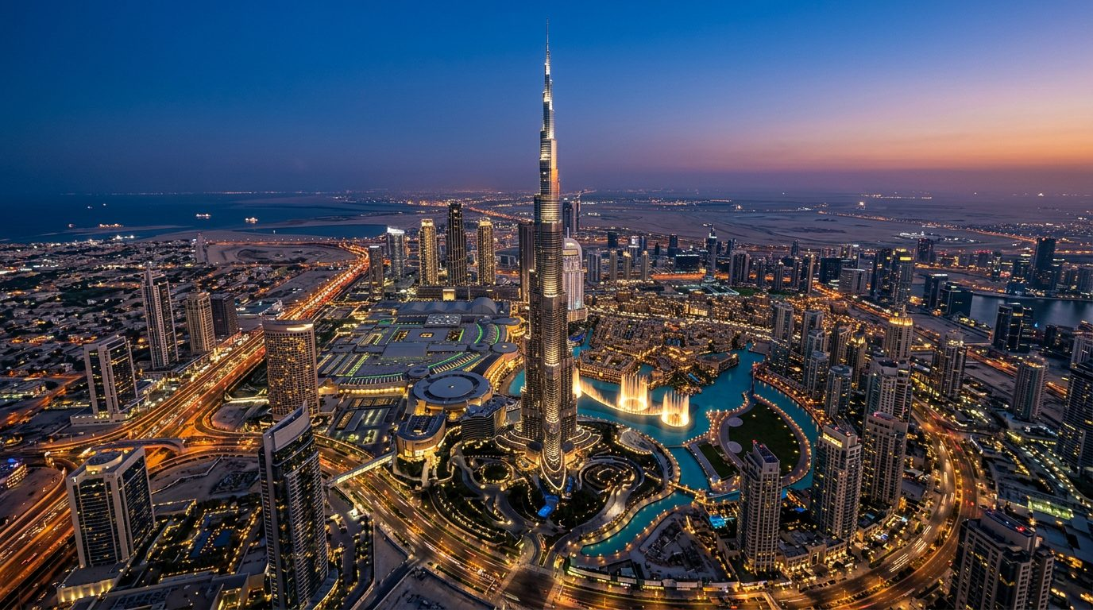
UAE EXAMPLE 1
Real Estate — Emaar Doesn't Sell Apartments
Emirati family aspires to: family legacy, stability, prestige.
Expat professional aspires to: wealth creation, residency security, global lifestyle.
Investor aspires to: financial freedom, international portfolio.
Emaar sells: downtown lifestyle, prestige, global identity.
Buying in the Burj Khalifa District means: "I have made it."
Dr. Aftab Ahmad | College Lecture — 07 June 2026
05 / 15

Slide 6
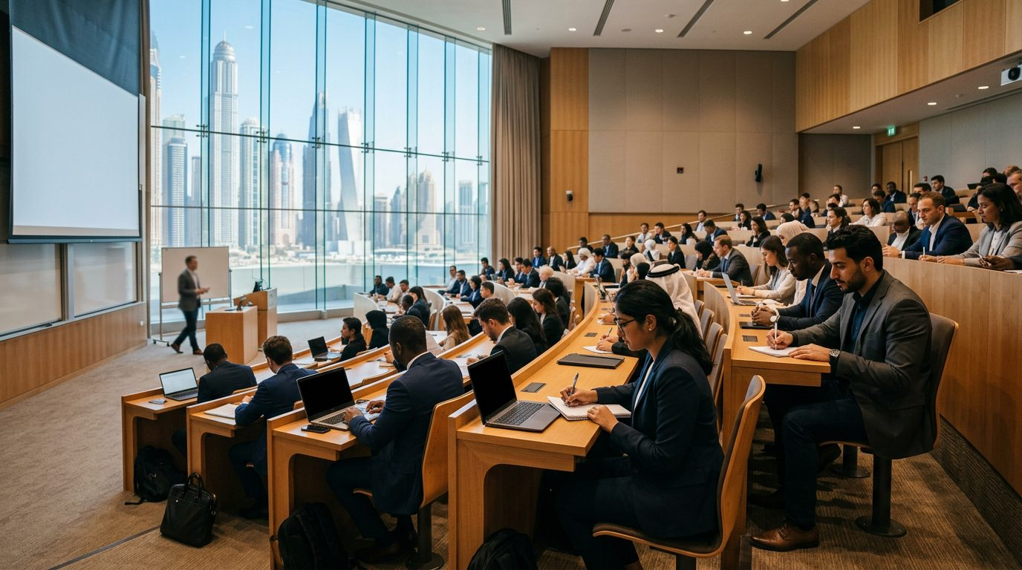
UAE EXAMPLE 2
Higher Education — You Don't Sell an MBA
Students aspire to: career growth, promotion, leadership, entrepreneurship, higher salary.
A Dubai manager earning AED 15,000 joins an MBA — not for lectures.
He is buying future CEO potential, professional credibility, and access to better opportunities.
Dr. Aftab Ahmad | College Lecture — 07 June 2026
06 / 15

Slide 7
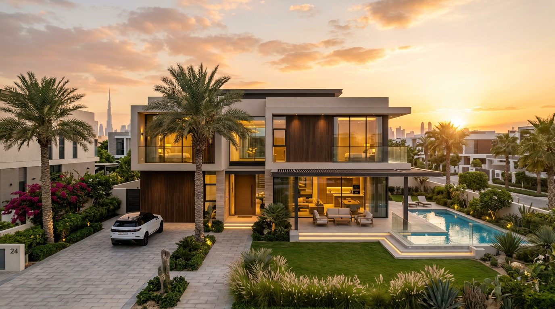
UAE EXAMPLE 3
Banking — "My Family Deserves Better"
Banks think: "We offer loans." Customers think: "My family deserves a better future."
Emirates NBD does not just sell mortgages — customers buy home ownership, security, family stability.
Wealth management clients do not buy investment products — they buy retirement confidence, children's education, financial independence.
Dr. Aftab Ahmad | College Lecture — 07 June 2026
07 / 15

Slide 8
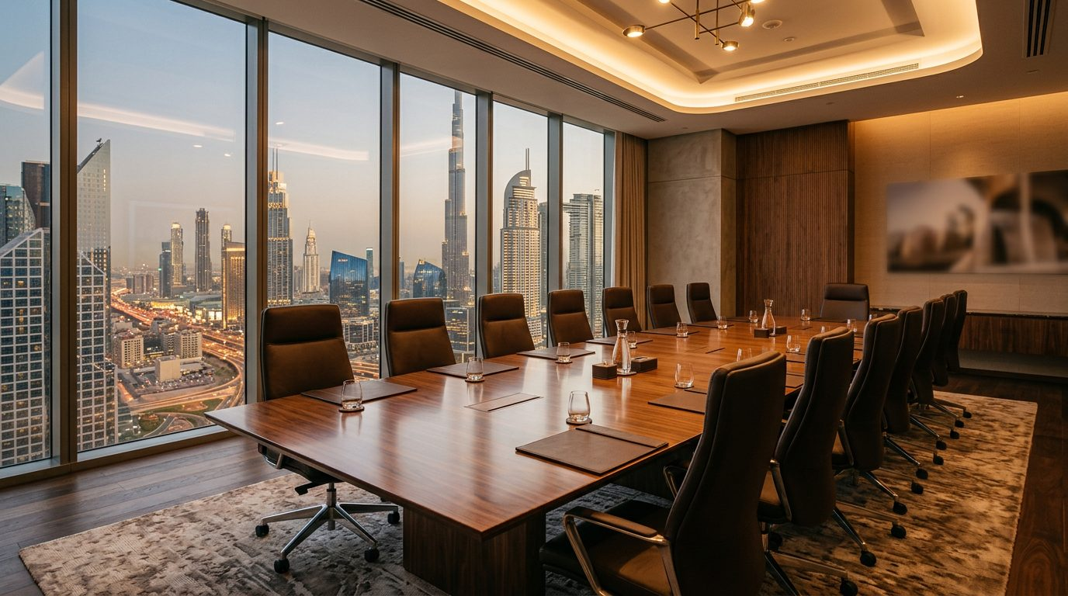
UAE EXAMPLE 4
Recruitment — Companies Don't Hire People
Employers aspire to: build world-class organizations, reduce hiring mistakes, scale rapidly.
A Dubai logistics company hiring a Supply Chain Director aspires to become the GCC market leader.
Young professionals want: better salary, career growth, international exposure.
Mid-career managers want: leadership role, respect, stability.
Senior executives want: legacy, influence, strategic impact.
Dr. Aftab Ahmad | College Lecture — 07 June 2026
08 / 15

Slide 9
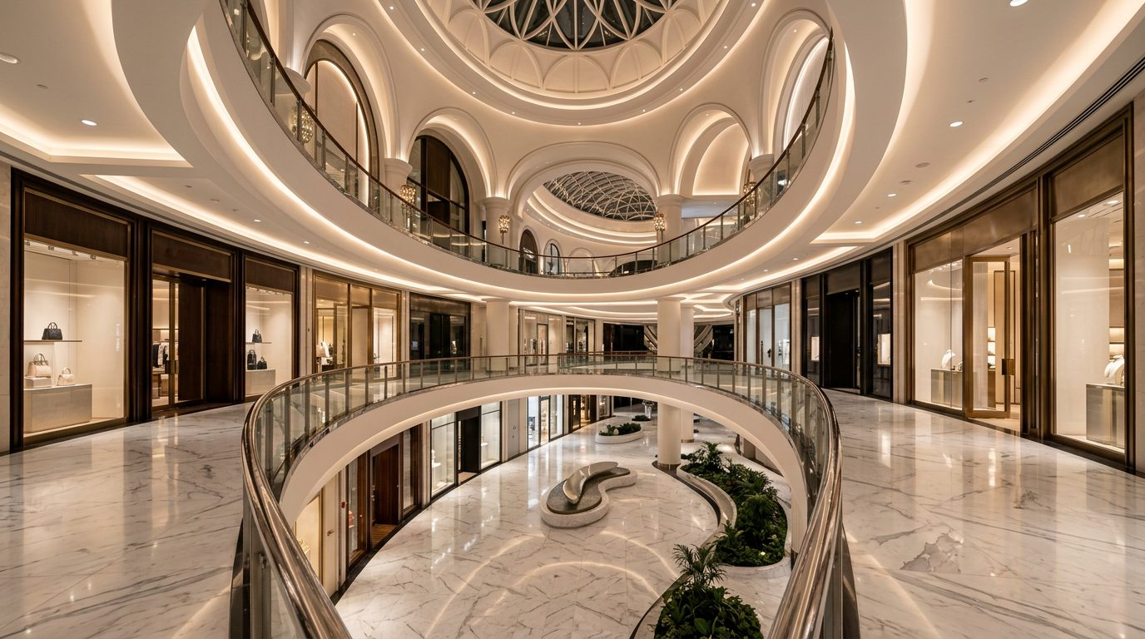
UAE EXAMPLE 5
Luxury Retail at Dubai Mall
Louis Vuitton customers are not buying leather bags — they buy status, exclusivity, and achievement.
Rolex customers are not buying a watch — they buy recognition, success, and personal achievement.
Dr. Aftab Ahmad | College Lecture — 07 June 2026
09 / 15

Slide 10
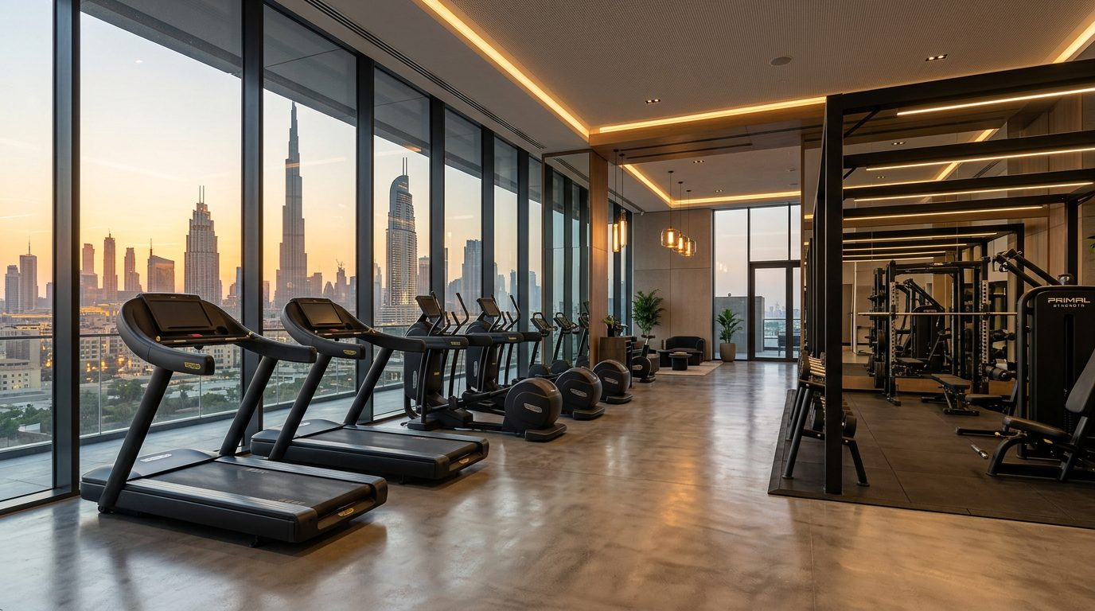
UAE EXAMPLE 6
Fitness — Selling a New Self
People do not buy gym memberships.
They aspire to better health, better appearance, confidence, and discipline.
In the UAE, fitness is also social image and personal branding.
Dr. Aftab Ahmad | College Lecture — 07 June 2026
10 / 15

Slide 11

SLIDE 11 OF 15
The Aspiration Gap
Pine's central concept: Current State → Desired Future State.
Middle Manager → General Manager · Gap: Leadership · Solution: MBA.
Tenant → Property Owner · Gap: Financing · Solution: Bank + Developer.
Job Seeker → Successful Professional · Gap: Opportunity · Solution: Recruiter.
Dr. Aftab Ahmad | College Lecture — 07 June 2026
11 / 15

Slide 12

SLIDE 12 OF 15
What UAE Companies Should Ask
Stop asking: What do you need? What features do you want? Are you satisfied?
Start asking: What are you trying to achieve in the next five years?
What does success look like for you? What kind of life are you building?
What is your biggest ambition? What would make you feel successful?
Dr. Aftab Ahmad | College Lecture — 07 June 2026
12 / 15

Slide 13

CLASSROOM ACTIVITY
Group Exercise
Choose one UAE company: Emaar · Emirates Airline · Emirates NBD · Dubai Holding · Talabat · Careem · Noon · Fitness First.
Step 1: What product or service does the company sell?
Step 2: What customer need does it satisfy?
Step 3: What customer aspiration does it fulfill?
Dr. Aftab Ahmad | College Lecture — 07 June 2026
13 / 15

Slide 14

SLIDE 14 OF 15
Key MBA Lesson
Companies that understand needs can survive.
Companies that understand aspirations can lead.
The most successful UAE brands help customers move closer to the future they dream about.
Dr. Aftab Ahmad | College Lecture — 07 June 2026
14 / 15

Slide 15
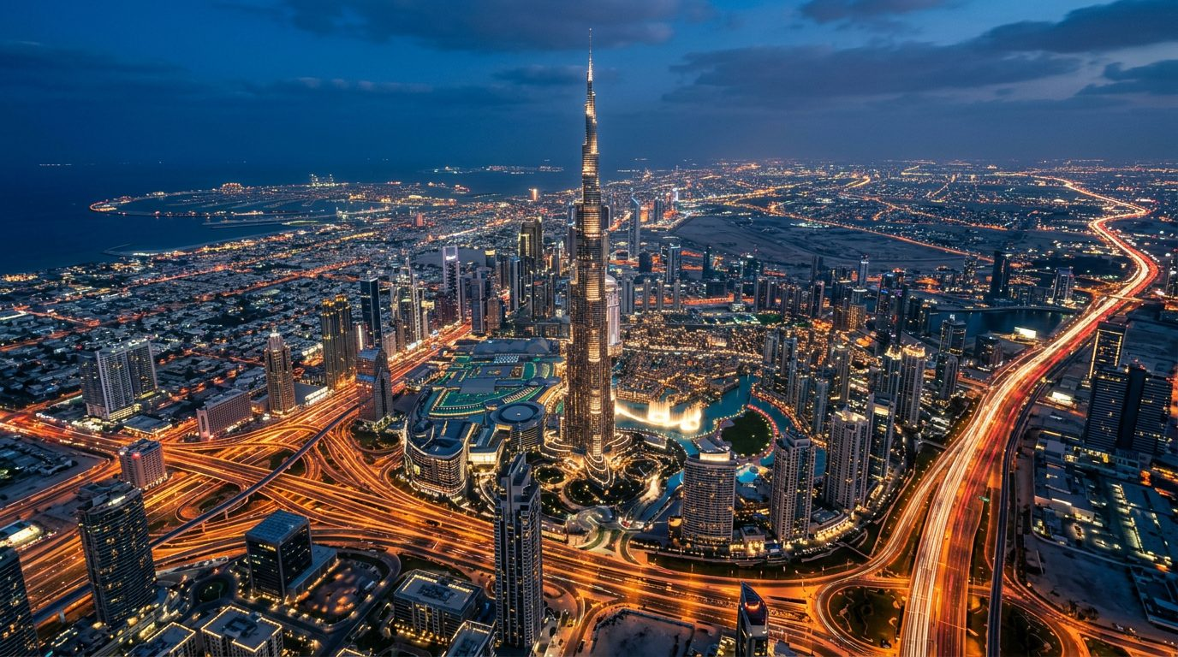
SLIDE 15 OF 15
Final Takeaway
Needs explain purchases. Aspirations explain loyalty.
Understanding aspirations creates deeper emotional connections, stronger relationships, and sustainable competitive advantage.
Thank you. — Dr. Aftab Ahmad
Dr. Aftab Ahmad | College Lecture — 07 June 2026
15 / 15

