Slide 1

LEADING NATIONAL ACADEMY · AL-KHOBAR · CPD
1
AI Tools for Effective Teaching
For LNA academic and administrative staff
Notes:
TIME: 2 min while people join the Teams call
SAY:
"Good morning everyone, and thank you to Lulu and the LNA team for having me.
Before we start, please open one AI tool in your browser. Microsoft Copilot, ChatGPT or Gemini. Any of them is fine.
Here is today in one sentence. AI writes the first draft. You make it good.
Trainers, you will leave with a lesson and a quiz for your own programme. Admin team, you will leave with a faster way to write emails, meeting minutes and reports."
DO:
Put the main links in the Teams chat. Ask people to keep their camera on for the activities if they can.
TRANSITION:
"Here is the whole session on one page."

Slide 2
TODAY ON ONE PAGE
2
8 steps. One real result.
10
min
10
min
15
min
10
min
10
min
10
min
10
min
10
min
AI basics
Tools
Prompts
Lesson plan
Quiz
Admin work
Safe use
Your challenge
Trainers: lesson + quiz. Admin: emails + minutes + reports.
Notes:
TIME: 1 min
SAY:
"Eight steps. Each one ends with something you made. Trainers, steps four and five are yours. Admin team, step six, the orange one, is built for you. Everyone does step seven and the final challenge.
One rule for today. When the timer is on screen, you work. When it stops, we share."
DO:
Keep to time. If the session is shorter than planned, cut the videos first, never the final challenge.

Slide 3

1 · AI BASICS
3
AI is a fast intern
It drafts. You decide.
Notes:
TIME: 4 min
SAY:
"Look at this picture. A robot hand passes a draft. A human hand holds the red pen. That is the whole relationship.
Think of AI as a very fast intern who has read a million textbooks. Ask for a quiz and you have one in five seconds.
But this intern has never met your trainees. It does not know the TVTC curriculum or LNA's standards. And sometimes it says something wrong with total confidence.
So the intern drafts. You decide what reaches your trainees."
ASK:
"What took you the most time last week that was not teaching or real admin work?" Take three answers and type them into the Teams chat. We come back to them in the final challenge.

Slide 4
1 · AI BASICS
4
Where AI helps. Where you check.
AI IS GOOD AT
YOU ALWAYS CHECK
✓
First drafts
!
Facts and numbers
✓
Ideas
!
Safety rules
✓
Quiz questions
!
Saudi regulations
✓
Summaries
!
Your trainees’ level
Notes:
TIME: 3 min
SAY:
"Left side, green light. AI is great at first drafts, ideas, quiz questions and summaries.
Right side, red light. You always check facts and numbers, safety rules, Saudi regulations, and whether it suits your trainees' level.
At LNA this matters even more. A wrong step in an electrical or HVAC procedure is a safety problem, not just a typo."
ASK:
"Has anyone already caught AI making a mistake?" One quick story is enough.

Slide 5
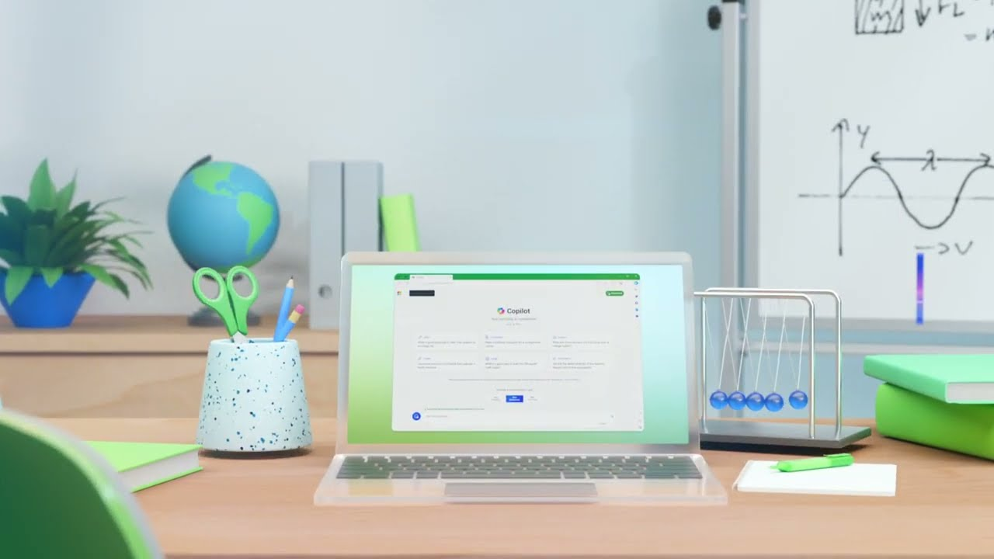
VIDEO · 35 SECONDS
5
Copilot at work
Ask: which task could AI do faster for you?
Notes:
TIME: 2 min
DO:
Click the picture to open YouTube. Share your screen WITH computer sound in Teams (Share > include sound). The clip has music and no narration, so say that first.
SAY:
"35 seconds. Watch what the teacher asks Copilot to do. LNA already works in Microsoft Teams and Outlook, so this is the tool closest to your daily work."
ASK:
"Which task could AI do faster for you?" Take answers in the chat.

Slide 6
2 · TOOLS
6
Pick one tool. Learn it well.
Copilot
ChatGPT
Gemini
Canva AI
Inside Teams, Outlook and Word
Plan, explain, write
Ideas and Google tools
Slides and posters
The tool matters less than the way you ask.
Notes:
TIME: 6 min
SAY:
"Four tools, four jobs.
Copilot lives inside Teams, Outlook and Word. Since LNA runs on Microsoft, this is the easiest place for most of you to start.
ChatGPT is the all-rounder for planning, explaining and writing.
Gemini is strong for ideas and works with Google tools.
Canva AI is for anything visual: slides, posters, worksheets.
Here is the important line at the bottom. The tool matters less than the way you ask. A good prompt in any of them beats a bad prompt in the best one. So pick the one you already have and learn it well."
DO:
Before the session, check with LNA IT (Lulu) which tools staff are allowed to use, and say it here.
ASK:
"Type in the chat which tool you have open right now."

Slide 7
3 · PROMPTS · THE METHOD
7
The 5-block prompt
ROLE
CONTEXT
TASK
LIMITS
FORMAT
+
+
+
+
Who is the AI?
Who are the trainees?
What do you need?
How long? How hard?
Table? Steps?
Brief AI like you brief a substitute teacher.
Notes:
TIME: 5 min
SAY:
"Imagine you are off sick tomorrow and a substitute teacher covers your class. You would not leave a note that just says 'teach air conditioning.'
You would say who they are covering for. Who the trainees are. What to teach. How long, how hard. And how to run it.
That note has five blocks. A good AI prompt has the same five.
ROLE. Who should the AI be? 'You are an HVAC instructor.'
CONTEXT. Who are the trainees? 'First-year diploma students.'
TASK. What exactly do you need? 'A 30-minute lesson.'
LIMITS. Time, length, difficulty. 'Simple English, one activity.'
FORMAT. How should it look? 'A table with timings.'
Leave one block out and the AI guesses. It usually guesses wrong."
DO:
Ask everyone to write ROLE, CONTEXT, TASK, LIMITS, FORMAT on a sticky note or in their notes. They will use it all session.

Slide 8
3 · PROMPTS · REAL LNA EXAMPLE: HVAC TECHNICIAN
8
Weak prompt vs strong prompt
“Make a lesson about air conditioners.”
WEAK
ROLE
You are an HVAC instructor at a Saudi vocational academy.
CONTEXT
My trainees are first-year diploma students, new to refrigeration.
TASK
Plan a 30-minute lesson on how a split AC cools a room.
LIMITS
Simple English. One hands-on activity. A 5-question exit quiz.
FORMAT
Give it as a table with timings.
Notes:
TIME: 4 min (live demo)
SAY:
"Here is a real example from our HVAC Technician diploma.
The weak prompt: 'Make a lesson about air conditioners.' The AI has to guess everything. What level? How long? Theory or practical? You get something generic.
The strong prompt has all five blocks. Look at the colours. Role, context, task, limits, format."
DO (live):
Share your screen. Paste the weak prompt into Copilot or ChatGPT. Then paste the strong one. Scroll through both answers side by side.
STRONG PROMPT TO PASTE:
You are an HVAC instructor at a Saudi vocational academy. My trainees are first-year diploma students, new to refrigeration. Plan a 30-minute lesson on how a split AC cools a room. Use simple English, one hands-on activity and a 5-question exit quiz. Give it as a table with timings.
ASK:
"Which one could you teach from tomorrow morning?"

Slide 9
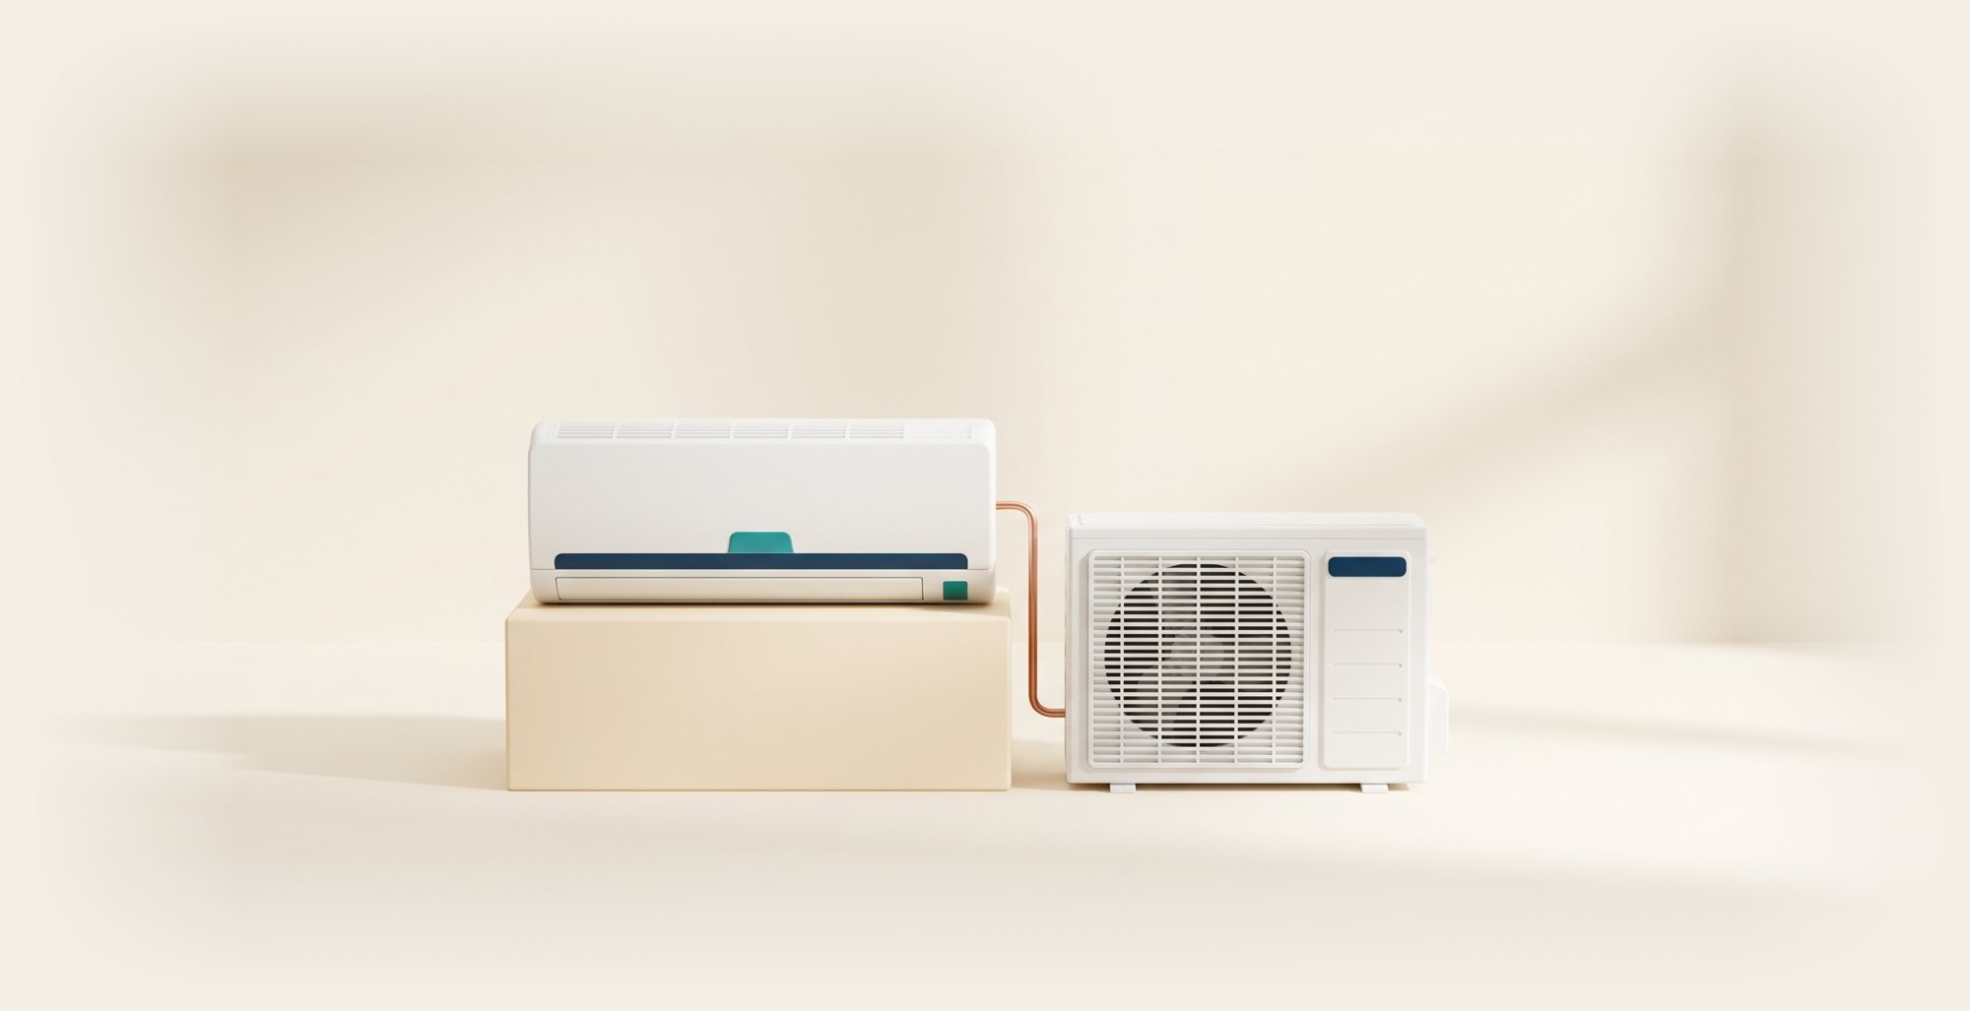
3 · PROMPTS · WHAT THE STRONG PROMPT GIVES BACK
9
A 30-minute lesson in seconds
5 min
HOOK
10 min
EXPLAIN
10 min
HANDS-ON
5 min
QUIZ
Why is the room cold but the outside unit hot?
The 4 parts: compressor, condenser, expansion valve, evaporator
Pairs label the 4 parts on a split-unit diagram
5 quick questions, swap and mark
Your job: check it, fix it, then teach it.
Notes:
TIME: 2 min
SAY:
"This is the shape of what came back. A hook, an explanation, a hands-on task and a quiz. Thirty minutes, planned in about ten seconds.
Now the important part. Check it. Are the four parts right? Yes: compressor, condenser, expansion valve, evaporator. Is the activity safe and possible in our lab? Is the English simple enough for first-year trainees?
AI did the typing. You did the teaching judgment."

Slide 10
ACTIVITY 1 · BUSINESS ADMINISTRATION · IN PAIRS
⏱ 7 min
10
Fix the prompt
ROLE
write yours…
“Create questions about Excel.”
CONTEXT
write yours…
TASK
write yours…
LIMITS
write yours…
FORMAT
write yours…
Run it. Compare with your partner.
Notes:
TIME: 7 min work + 2 min share
SAY:
"Your turn. This weak prompt comes from our Business Administration diploma: 'Create questions about Excel.'
Rewrite it with the five blocks. Run it in your AI tool. Then compare with your partner. Whose answer is more useful, and why?
Admin team, join in. This works for any task."
DO:
Start the timer. Use Teams breakout rooms of 2 or 3 if you can. Visit rooms and ask stuck pairs: "Who are the learners? How many questions? What kind?"
MODEL ANSWER (share if needed):
You are a computer skills trainer at a Saudi vocational academy. My trainees are first-year Business Administration diploma students who know basic Excel. Create 8 questions on SUM, AVERAGE and cell references: 4 multiple-choice and 4 practical tasks. Present them in a table with the answer in the last column.
SHARE:
Two pairs read their before and after prompts aloud.

Slide 11
4 · LESSON PLAN · THE METHOD
11
A lesson plan in 4 steps
1
2
3
4
PICK
PROMPT
CHECK
TEACH
one topic from your programme
with the 5 blocks
facts, safety, level
then improve it
Step 3 is the step only you can do.
Notes:
TIME: 2 min
SAY:
"Four steps for every lesson.
One, pick a real topic from your programme.
Two, prompt with the five blocks.
Three, check it. Facts, safety, the level of your trainees.
Four, teach it, and improve it next time.
AI does step two in seconds. Step three is the step only you can do. That is your expertise."

Slide 12
ACTIVITY 2 · EVERYONE WITH A PROGRAMME
⏱ 10 min
12
Build your lesson
Health & Safety
HVAC Technician
Supply Chain
Electrical Technician
QC Building Inspection
Business Administration
Chemical Lab Technician
Ask for: objectives · intro · activity · quiz · support for weaker trainees
Output: a 30-minute lesson you can use next week.
Notes:
TIME: 10 min
SAY:
"These are LNA's seven diploma programmes. Pick yours. Pick one real topic you will teach in the next two weeks.
Ask AI for a 30-minute lesson with five parts: objectives, an introduction, one activity, a short quiz, and support for weaker trainees. Use the five blocks."
PROMPT TO PASTE IN THE TEAMS CHAT:
You are an experienced [programme] instructor at a Saudi vocational academy for women. My trainees are [first / second]-year diploma students. Plan a 30-minute lesson on [topic]. Include learning objectives, a 5-minute introduction, one hands-on activity, a short quiz, and how to support weaker trainees. Give it as a table with timings.
DO:
Ask each person: "What would you change before you teach this?" That question is the point of the activity.
Admin team: use these 10 minutes to try the admin examples coming up in step 6, or pair with a trainer.

Slide 13
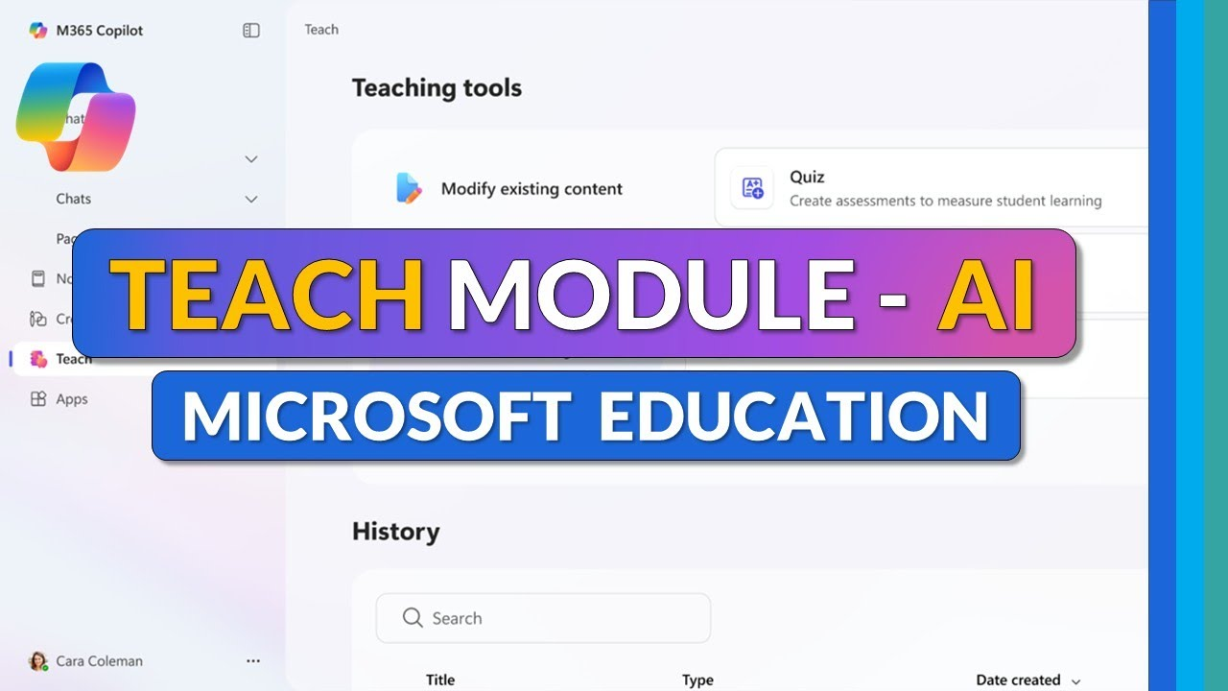
VIDEO · FIRST 3 MINUTES
13
Watch a lesson get built
Ask: which part would you use first?
Notes:
TIME: 3 min (play the opening only)
DO:
Click the picture to open YouTube. Share screen with sound. Stop once the lesson plan has been generated.
SAY:
"Watch how the teacher gives context before asking for anything. That is the five blocks in action."
ASK:
"Which part would you use first?"

Slide 14
5 · QUIZ · THE METHOD
14
Every quiz: 2 + 2 + 1
2
2
1
+
+
multiple choice
short answer
real-life scenario
Then ask: “Give the answers and explain each one.”
Notes:
TIME: 2 min
SAY:
"Remember this pattern: two, two, one. Two multiple-choice. Two short-answer. One scenario, where trainees use what they know in a real workplace situation.
Then the trick. Ask a second time: 'Give the answers and explain each one.' Read the explanations. That is where you catch AI mistakes. If the explanation is weak, the question is weak too."

Slide 15

5 · QUIZ · REAL LNA EXAMPLE: HEALTH & SAFETY
15
Two questions AI wrote
MULTIPLE CHOICE
SCENARIO
Which colour safety sign means you MUST do something?
A chemical has spilled near the workshop exit. What are your first 3 actions?
A Red
B Blue ✓
1 Warn people, keep them away
C Yellow
2 Tell the supervisor
D Green
3 Check the safety data sheet
Check every answer before trainees see it.
Notes:
TIME: 3 min
SAY:
"Two questions AI wrote for our Health and Safety diploma.
The multiple-choice one: which colour safety sign means you must do something? The answer is B, blue. Blue round signs are mandatory signs, like 'wear eye protection'.
The scenario: a chemical spill near the workshop exit. The model answer: warn people and keep them away, tell the supervisor, then check the safety data sheet before anyone cleans up.
Both are good. But notice: I checked them. If AI had said red for mandatory, that is a safety mistake reaching a trainee. You are the last check."
ASK:
"Health and Safety trainers, would you change anything in the model answer?"

Slide 16
ACTIVITY 3 · TRAINERS
⏱ 8 min
16
Make your quiz
1
Paste your lesson from Activity 2
2
Ask for 2 + 2 + 1 questions
3
Ask for answers with reasons
Output: a quiz with an answer key.
Notes:
TIME: 8 min
PROMPT TO PASTE IN THE TEAMS CHAT:
Using the lesson above, create 5 questions: 2 multiple-choice, 2 short-answer and 1 workplace scenario question. Then give the correct answers with a one-line explanation for each.
DO:
Ask one volunteer to read their scenario question aloud. Ask the room: "Is it fair? Is it clear? Is the answer right?"

Slide 17

DIFFERENTIATE
17
Same goal. Three paths.
Every trainee reaches the flag. The route is different.
Notes:
TIME: 2 min
SAY:
"One mountain, one flag, three ways up. A gentle ramp, a staircase and a ladder.
That is differentiation. Same goal for every trainee, different routes depending on where she starts.
Doing this by hand takes ages. With AI it is one prompt."

Slide 18
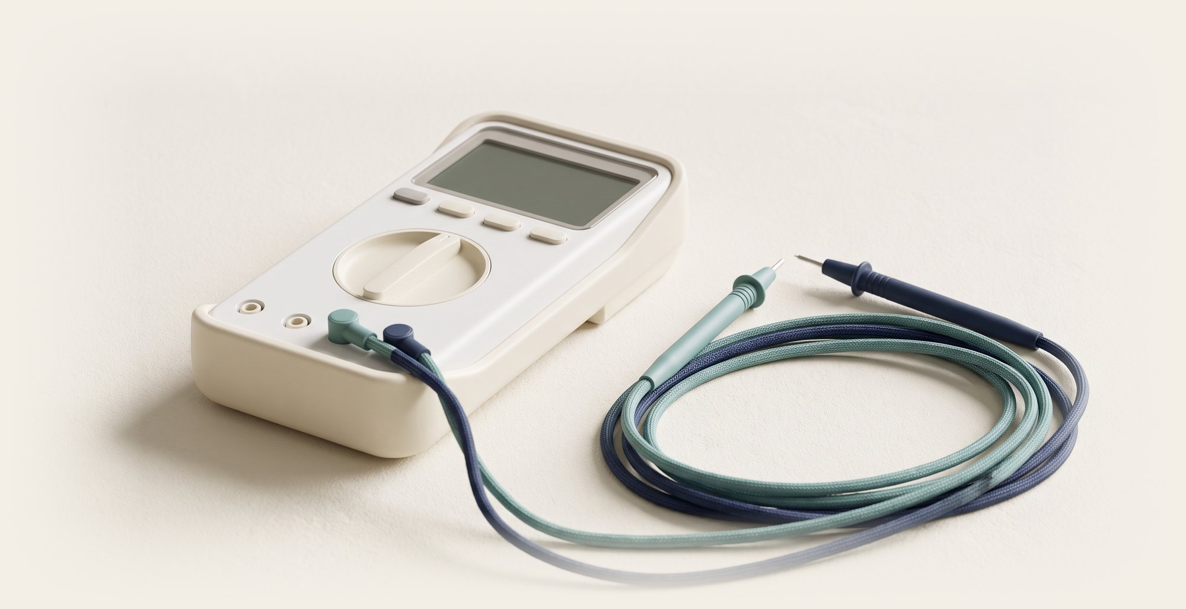
DIFFERENTIATE · REAL LNA EXAMPLE: ELECTRICAL TECHNICIAN
18
One goal, three levels
GOAL: measure voltage safely with a multimeter
ADVANCED
Find the fault in a circuit. Write a 5-line report
MIDDLE
Measure 3 practice circuits in pairs. Record the readings
BEGINNER
Label the parts of a multimeter on a photo
Notes:
TIME: 3 min
SAY:
"Real example from our Electrical Technician diploma. One goal: measure voltage safely with a multimeter.
Beginner: label the parts of a multimeter on a photo.
Middle: measure three practice circuits in pairs and record the readings.
Advanced: find the fault in a circuit and write a five-line report.
Same flag. Three routes. Notice the steps get taller, like the staircase on the mountain."
PROMPT:
Learning goal: measure voltage safely with a multimeter. Create three activities that all meet this goal: one for beginners, one for middle-level trainees, one for advanced trainees. For each, give the instructions to trainees and the time needed.
ASK:
"Does the advanced task still meet the same goal, or did AI change the goal?" This is a common AI slip.

Slide 19
ACTIVITY 4 · TRAINERS
⏱ 8 min
19
Three levels, one goal
1
Pick one goal from your lesson
2
Ask for beginner, middle, advanced
3
Check all 3 reach the same goal
Output: three activities for one goal.
Notes:
TIME: 8 min
DO:
Trainers work alone or in pairs. Share one example at the end.
ASK:
"Who found that AI changed the goal for the advanced level?" Praise anyone who caught it.

Slide 20

6 · PART 2 · LNA ADMINISTRATION
20
AI for daily admin work
Draft in minutes. Check. Send.
Notes:
TIME: 1 min
SAY:
"Now the part for our administration team. Trainers, stay with us. You write emails and attend meetings too.
Same idea as before. AI drafts in minutes. You check. Then you send."

Slide 21
6 · ADMIN · THE METHOD
21
4 daily jobs AI can draft
1
2
3
4
Emails
Meetings
Reports
Notices
Sponsor updates, replies, reminders
Teams recap into actions
Attendance into a summary
Announcements in Arabic and English
Same 5 blocks. Different job.
Notes:
TIME: 2 min
SAY:
"Four jobs that fill an admin week.
Emails: updates to sponsoring companies, replies, reminders.
Meetings: turn a Teams recap into a clear action list.
Reports: turn an attendance export into a summary.
Notices: announcements for trainees and staff, in Arabic and English.
And the method does not change. Same five blocks, different job."

Slide 22
6 · ADMIN EXAMPLE 1 · EMAIL TO A SPONSOR
22
A sponsor email in 20 seconds
YOU TYPE
AI GIVES YOU
You are an admissions officer at a Saudi training academy. Write a short, polite email to a sponsoring company. Say the mid-term progress report for their sponsored trainees is attached. Offer a Teams call next week. Under 100 words.
Subject: Mid-term progress report
Dear [Name],
Please find attached the mid-term progress report for the trainees your company sponsors. We are glad to discuss it with you. Would a short Teams call next week suit you? Please share a time that works.
Kind regards, [Your name]
No trainee names or IDs in the prompt.
Notes:
TIME: 3 min (live demo)
SAY:
"Admin example one. An email to a company that sponsors our trainees.
Left side: what you type. Look, it still has the five blocks. Role: admissions officer. Context: a sponsoring company. Task: the email. Limits: under 100 words. And the format is an email.
Right side: what AI gives back in about 20 seconds. You add the name and attach the report.
And the red line at the bottom. The prompt has no trainee names and no ID numbers. The report stays in our system. AI only writes the covering email."
DO:
Run the prompt live in Copilot or Outlook's Copilot if available.

Slide 23

6 · ADMIN EXAMPLE 2 · TEAMS MEETING
23
Meeting notes into actions
YOU TYPE
“From this meeting recap, list the decisions, owners and deadlines as a table.”
DECISION
OWNER
DEADLINE
Book the HVAC lab for practical week
Lab coordinator
Sunday
Send mid-term reports to sponsors
Admissions
Thursday
Plan CPD part 2
IT team
End of month
Sample rows for practice.
Notes:
TIME: 3 min
SAY:
"Admin example two. After a Teams meeting, Copilot in Teams can give a recap. If it is not available, paste your own rough notes into any AI tool.
Then one line: list the decisions, owners and deadlines as a table.
You get this. Who does what, by when. Paste it into the follow-up email and everyone knows their job."
NOTE: These rows are sample practice rows, not real LNA decisions. Say so if asked.
DO:
Check with Lulu whether Copilot meeting recap is switched on for LNA's Teams. If it is not, demo with pasted notes.

Slide 24
6 · ADMIN EXAMPLE 3 · WEEKLY REPORT
24
Attendance export into a summary
YOU TYPE
AI GIVES YOU
“Summarise this attendance sheet by programme. Show it as a bar chart. Flag any programme under 90%.”
96%
97%
95%
94%
93%
92%
88%
H&S
HVAC
SCM
Elec
QC
BA
Lab
Sample data. Remove names before you paste.
Notes:
TIME: 3 min
SAY:
"Admin example three. You export the weekly attendance sheet from the system. You remove the names and ID numbers. Then you ask AI to summarise it by programme, show a bar chart, and flag anything under 90 percent.
In this sample, Supply Chain is flagged in red at 88 percent. That is the one you look into.
These are sample numbers for practice, not real LNA figures."
IMPORTANT:
Before pasting any export into a public AI tool, delete trainee names, national ID numbers and phone numbers. Use only the counts. If LNA has an approved internal tool (for example Copilot with company data protection), use that.

Slide 25

7 · SAFE USE
25
The traffic light rule
GO
Ideas · drafts · lesson outlines · quiz drafts
CHECK FIRST
Facts · numbers · safety steps · regulations
NEVER
Trainee names · national ID · grades · health data
Saudi PDPL protects personal data. Follow LNA IT policy.
Notes:
TIME: 5 min
SAY:
"One rule to remember: the traffic light.
GREEN, go. Ideas, drafts, lesson outlines, quiz drafts. Use AI freely.
AMBER, check first. Facts, numbers, safety steps and regulations. AI can be wrong and sound completely sure. In a vocational academy, a wrong safety step matters.
RED, never. Trainee names, national ID numbers, grades and health information never go into a public AI tool.
Saudi Arabia's Personal Data Protection Law, the PDPL, protects personal data. And LNA's IT policy decides which tools are approved. When in doubt, ask Lulu and the IT team."
ASK:
"Where would you put: writing a parent or sponsor email with a trainee's grade in it?" (Answer: RED, unless the grade and name are removed.)

Slide 26
ACTIVITY 5 · DISCUSS IN GROUPS
⏱ 4 min
26
AI or human?
Ideas for Health & Safety awareness week
Decide if a trainee passes the diploma
A
B
First draft of an HVAC quiz
Paste a trainee’s ID and grades for a report
C
D
Notes:
TIME: 4 min (2 min groups, 2 min share)
SAY:
"Four real LNA situations. For each one: is it a job for AI, or for a human? Two minutes in your groups."
ANSWER KEY:
A. Ideas for Health & Safety week: AI is fine. Green light. You choose the ideas.
B. Deciding a pass or fail: HUMAN. It affects a young woman's career and her sponsor. It needs professional judgment and accountability.
C. First draft of an HVAC quiz: AI is fine, amber. Check every answer before trainees see it.
D. Pasting a trainee's ID and grades: NO. Red light. Personal data never goes into a public AI tool.
KEY LINE TO END ON:
"AI can draft. Only a human can decide."

Slide 27

8 · FINAL CHALLENGE
⏱ 10 min
27
Your 10-minute task
Make one real thing you need this week.
Notes:
TIME: 1 min to explain, then 10 min work
SAY:
"Remember the time-eaters we typed in the chat at the start? Pick one. A real task you need this week. Trainers, a lesson, a quiz or a worksheet. Admin, an email, a report or a notice.
Ten minutes. When the sand runs out, you should have something finished."

Slide 28
8 · FINAL CHALLENGE · 5 STEPS
28
Draft, improve, check, use
1
2
3
4
5
Pick a real task
Get a first draft
Improve the prompt
Check it
Save it and use it
Share it in the Teams chat when you finish.
Notes:
TIME: 10 min work + 3 min share
DO:
Start the timer. Give a 5-minute and a 1-minute warning. If someone is stuck choosing, suggest an exit ticket, a homework sheet, a sponsor email or a weekly notice.
SHARE:
"Who will use theirs this week? Paste it in the chat and tell us when you will use it."

Slide 29
KEEP THIS · TAKE A SCREENSHOT
29
Your prompt card
ROLE
Act as a [Supply Chain] instructor…
CONTEXT
My trainees are [first-year diploma students]…
TASK
Create [a 30-minute lesson on inventory]…
LIMITS
Keep it [simple English, one activity]…
FORMAT
Show it as [a table with timings].
Change the [brackets]. Keep the 5 blocks.
Notes:
TIME: 1 min
SAY:
"Take a screenshot of this slide now. It is the five blocks with a real example from our Supply Chain diploma. Change the words in the brackets for your own programme or task, and keep the five blocks."

Slide 30
KEY TAKEAWAY
30
Three words to remember
DRAFT
CHECK
USE
AI writes the first version
You fix facts, safety, level
Teach it. Send it. Improve it.
Notes:
TIME: 1 min
SAY:
"Three words. Draft: AI writes the first version. Check: you fix the facts, the safety and the level. Use: teach it, send it, and improve it next time.
That is the whole method. It works for a lesson, a quiz, an email or a report."

Slide 31

THANK YOU, LNA
31
Start small. Teach smarter.
One task this week. One class or one email.
Notes:
TIME: 2 min
SAY:
"A small seed growing out of a book. Start with one task this week. Not ten. One lesson, or one email.
Thank you to Lulu, Samar and the whole LNA team. Start small. Teach smarter."
DO:
Take questions. Share the page link azizsaif.com/ai-learning-LNA in the Teams chat so everyone keeps the slides, prompts and the prompt card.

Slide 32
TRAINER ONLY · SKIP WHEN PRESENTING
32
Run sheet
Slides | Step | Min | Output
1–4 | AI basics | 10 | Know what AI is good at
5–6 | Tools | 10 | One tool open
7–10 | Prompts + Activity 1 | 15 | One better prompt
11–13 | Lesson plan + Activity 2 | 10 | A 30-minute lesson
14–19 | Quiz + Differentiate | 10 | Quiz + 3 levels
20–24 | Admin work | 10 | Email, minutes, report
25–26 | Safe use | 10 | Traffic light rule
27–31 | Challenge + close | 10 | One real task done
Notes:
Trainer reference. About 85 minutes in total. For a 60-minute Teams slot, drop both videos, shorten Activities 3 and 4 to 5 minutes each, and keep the final challenge.
Before the session:
1. Confirm with Lulu (LNA IT) which AI tools staff may use, and whether Copilot meeting recap is on.
2. Test both YouTube links with "share sound" in Teams.
3. Paste the prompts from these notes into a document so you can drop them into the Teams chat.
4. Set up breakout rooms of 2 or 3 for the activities.

