Slide 1
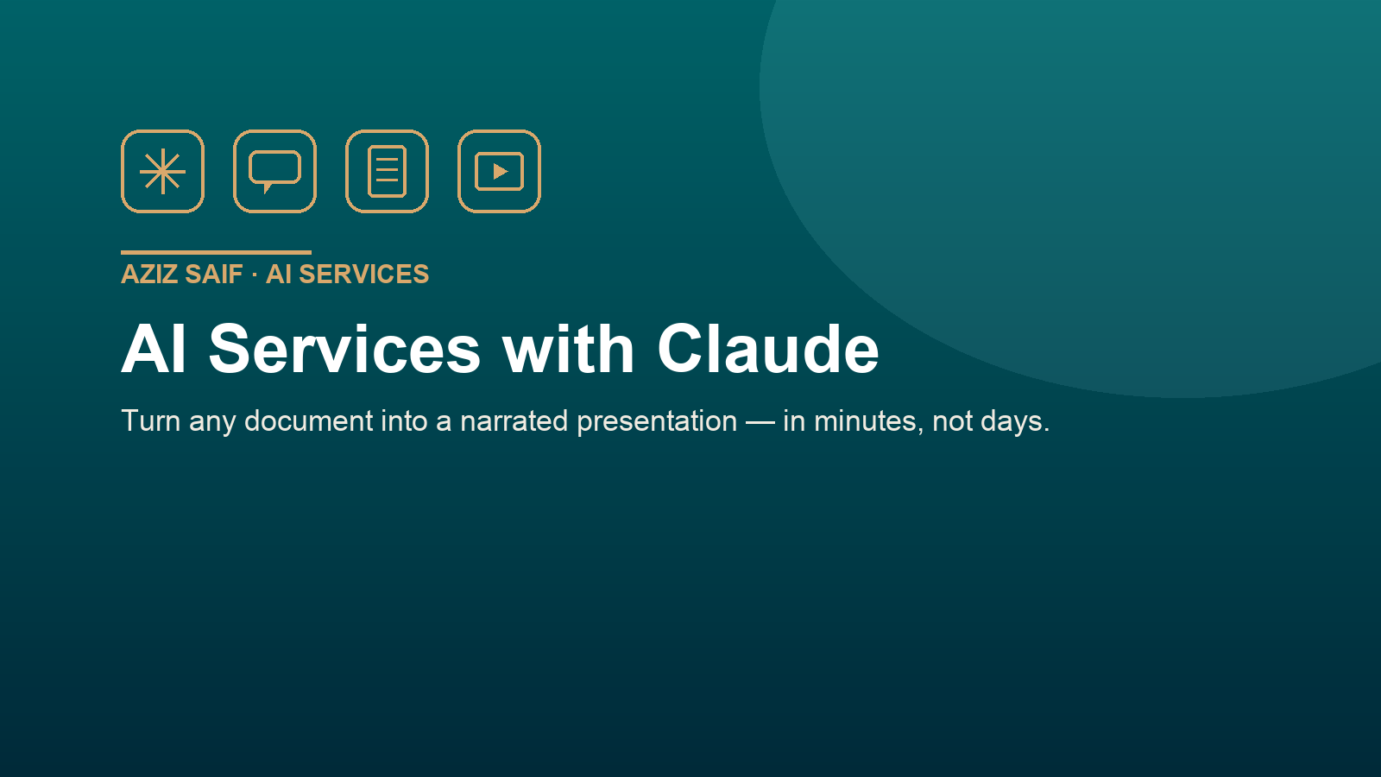

Slide 2
THE PROBLEM
Documents are static. Attention is not.
• A report, a proposal, or a lecture sits in a file nobody opens.
• Turning it into a polished, narrated deck takes hours of manual work.
• Sharing it usually means a flat PDF with no voice and no flow.
• By the time it looks good, the moment has passed.
02 / 08

Slide 3
THE IDEA
One upload → a complete presentation
• Drop a Word, PDF or PowerPoint into your private account.
• It is rewritten into clean slides: title, key points, and a narration script.
• You get an interactive web deck plus a downloadable PPT and PDF.
• Everything is indexed in one place and published to your blog.
03 / 08

Slide 4
HOW IT WORKS
The four-step pipeline
• 1. Upload — stage your file in the gated dashboard.
• 2. Convert — the content becomes slides with narration.
• 3. Publish — the deck is added to your private index.
• 4. Share — a blog card goes live with PPT and PDF links.
04 / 08

Slide 5
WHAT YOU GET
Play online, with a voice
• A full-screen player with back, pause, stop and forward controls.
• Voicebot narration that reads each slide aloud and auto-advances.
• A slide index and a thumbnail strip to jump anywhere instantly.
• Works on any device, straight from the browser — nothing to install.
05 / 08

Slide 6
WHAT YOU GET
Download as PPT and PDF
• A real PowerPoint file you can edit and present offline.
• A matching PDF for email, print, or quick review.
• Both are generated from the same source, so they always agree.
• Branded automatically in the Aziz Saif house style.
06 / 08

Slide 7
BUILT ON
The same studio as the Aftab lectures
• This reuses the exact deck engine behind the Dr Aftab Ahmad lectures.
• Proven layout, narration, and download workflow.
• Private by default — the workspace is password-protected.
• No duplicates: each document is published to the blog only once.
07 / 08

Slide 8
GET STARTED
Upload your first document
• Open your private account and drag a file into the upload box.
• Word, PDF or PowerPoint — all supported.
• Watch it appear in the index, ready to play and download.
• Then send it anywhere with a single link.
Aziz Saif AI · azizsaif.com/claude-account
08 / 08

